Slide 1
Introduction to Container Orchestration Platform
Application Modernization Series
Nuttee Jirattivongvibul
Specialist Solution Architect
Red Hat, Thailand

Slide 2
Application Modernization Series
Roadmap
Introduction to Container
DevOps and CI/CD
What & Why Container?
Docker
Demo: Build App & DB with Docker
DevOps and CI/CD Concept
Everything as-a-Code
Demo: Build and Deploy with CI/CD Tool
Session 4
25 Mar 2021 15:00
(45 mins - 1 hour)
Session 2
11 Mar 2021 15:00
(45 mins - 1 hour)
Session 1
4 Mar 2021 15:00
(45 mins - 1 hour)
Session 3
18 Mar 2021 15:00
(45 mins - 1 hour)
Application Modernization
Introduction to Container Orchestration Platform
How to containerize existing App?
Demo: Application Migration Tool, New Framework for Container
What & Why Container Orchestration Platform?
Basic concept of Application Deployment on Container Orchestration Platform with Demo

Slide 3
AGENDA
The Container Orchestrator
Why Container Platform?
DEMO: Code, Build and Deploy your Application to Container Platform

Slide 4
The Container Orchestrator

Slide 5
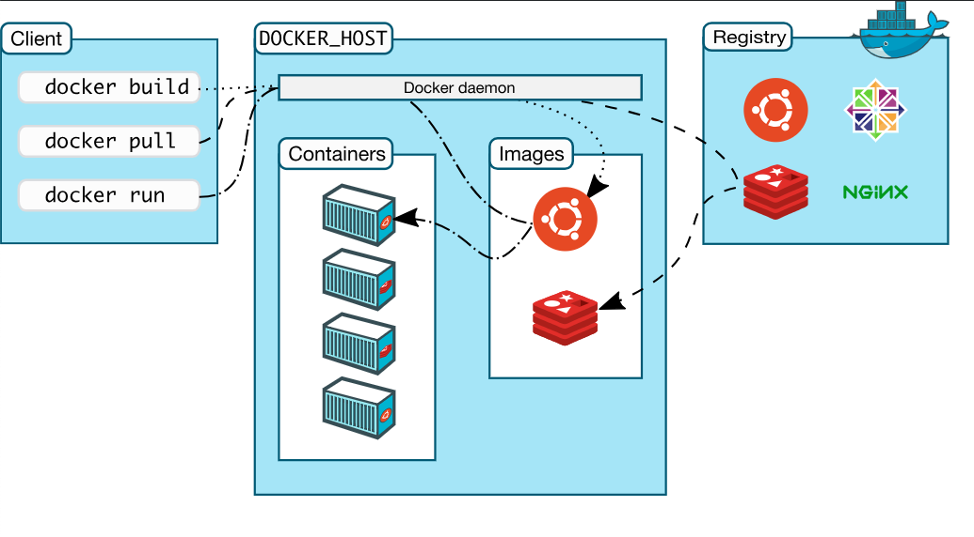
Docker/Container architecture

Slide 6


Operation Per Container
For Multiple Container….
Build image from Dockerfile
Pull image from Hub/Registry
Configure and Create container
Start and stop container
Stream their logs
Persistent
Network
etc.

Slide 7

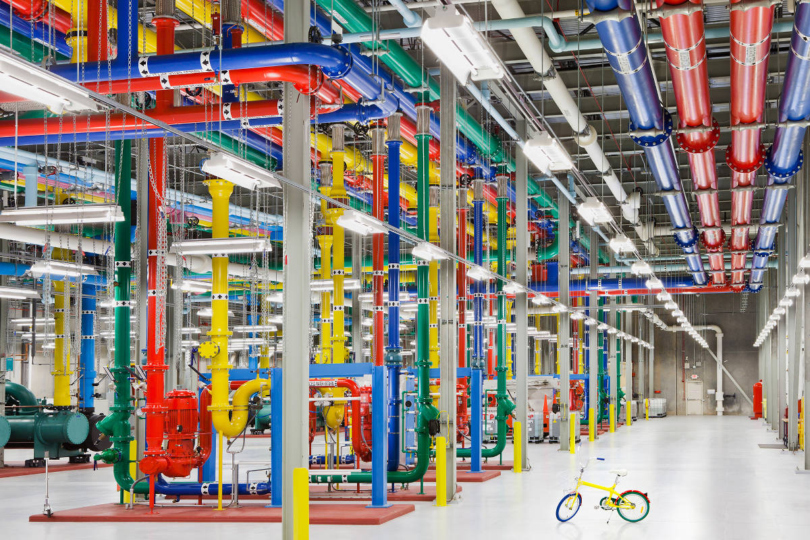

What is Kubernetes
Container Orchestration with Kubernetes
Kubernetes (also known as k8s or "kube") is an open source container orchestration platform that automates many of the manual processes involved in deploying, managing, and scaling containerized applications.
Kubernetes eliminates the manual process of deploying and scaling containerized applications.
Kubernetes was originally developed and designed by engineers at Google.
Google generates more than 2 billion container deployments a week, all powered by its internal platform, Borg.

Slide 8
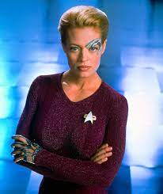

What is Kubernetes
Container Orchestration with Kubernetes
Kubernetes (also known as k8s or "kube") is an open source container orchestration platform that automates many of the manual processes involved in deploying, managing, and scaling containerized applications.
Kubernetes eliminates the manual process of deploying and scaling containerized applications.
Seven of Nine
(Ex-Borg)
Borg
Kubernetes was originally developed and designed by engineers at Google.
Google generates more than 2 billion container deployments a week, all powered by its internal platform, Borg.

Slide 9

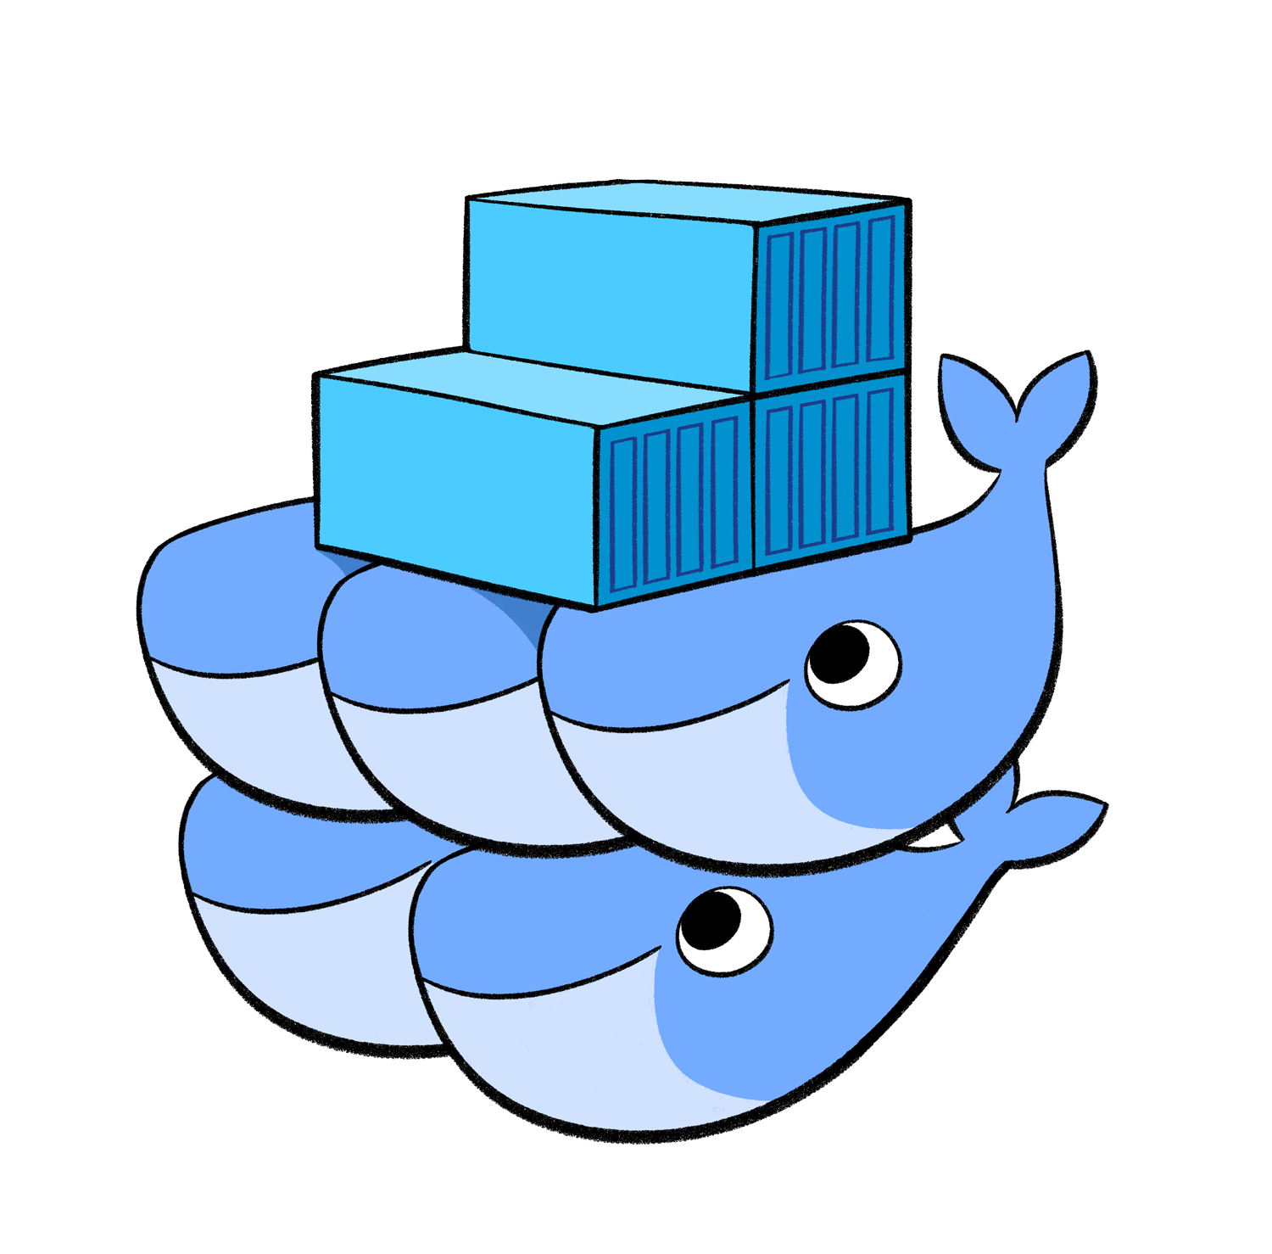
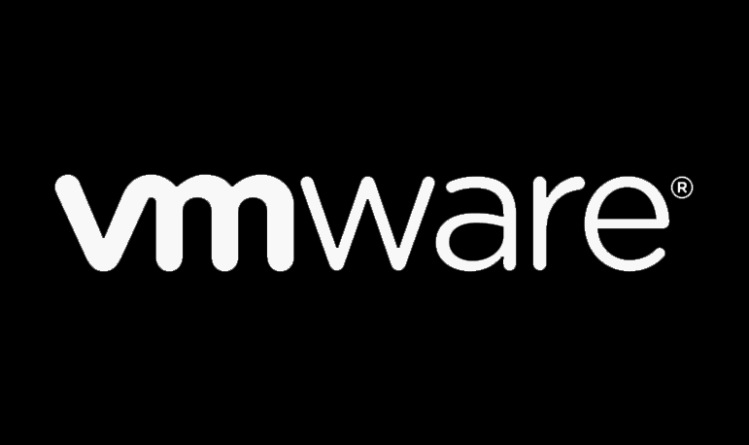








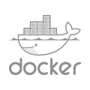
What are Container Orchestrator?
4-5 YEARS AGO
Fragmented landscape
TODAY
Kubernetes consolidation
OTHER ORCHESTRATORS
(Cloud Foundry Diego, Nomad, Blox, etc.)
OTHER
ORCHESTRATORS
Notes:
Industry has converged on Kubernetes and OpenShift no longer the defacto K8 distribution, customers have choice and we need to adapt the way we sell to our customers. With more and more power shifting to developers, its imperative we identify and work with them early in the sales cycle.

Slide 10
Docker(Docker Compose) vs k8s
Docker (Docker Compose)
Kubernetes
Run and manage container on a single container host
Build Container Image
Start/Stop a container
Start/Stop multiple containers（Docker Compose)
Manage Container Engine as a Cluster (Container Orchestration)
Replica Set, Auto-scaling, Self-healing
Service IP (ClusterIP), Service Discovery, Ingress Service
Persistent Storage
Docker Compose
(manage multiple containers)
Container
Container
Container
Container
Container
Container
Container Engine/Runtime
Container Engine/Runtime
Linux
Linux
Container
Container
Container
Container
Container
Container
Container
Container
Container
Container Engine/Runtime
Container Engine/Runtime
Container Engine/Runtime
Linux
Linux
Linux

Slide 11

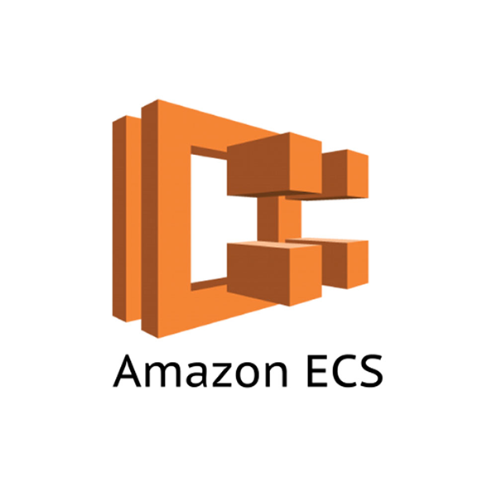
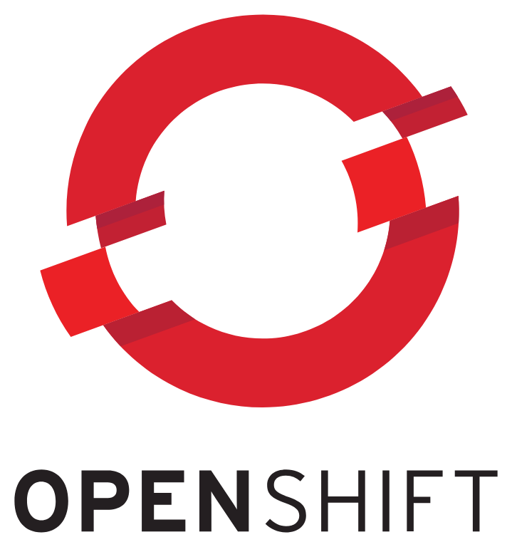


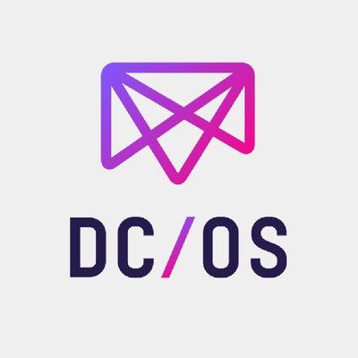
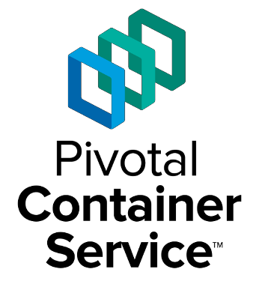
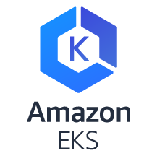

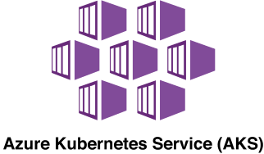
Container Orchestration Timeline
Initial Release by Red Hat not based on Docker
Docker releases Swarm
Google open-sources Kubernetes
Decision to Standardize on Kubernetes
ECS Launched
Kubernetes 1.0 Released
May 2011
Dec
2013
June 2014
Oct
2014
July
2015
July
2015
3.0 release with Kubernetes
Rancher releases 1.0
Mesosphere releases DC/OS 1.0
Pivotal releases PCS
AWS introduces Kubernetes Service
Azure introduces Kubernetes Service
Nov
2015
March 2016
April 2016
August
2017
June 2018
June 2018

Slide 12
Kubernetes Concept

Slide 13
OpenShift Concepts
a container is the smallest compute unit
CONTAINER

Slide 14
OpenShift Concepts
containers are created from container images
IMAGE
CONTAINER
BINARY
RUNTIME

Slide 15
OpenShift Concepts
container images are stored in an image registry
IMAGE REGISTRY
IMAGE
IMAGE
IMAGE
CONTAINER
IMAGE
IMAGE
IMAGE

Slide 16
OpenShift Concepts
an image repository contains all versions of an image in the image registry
IMAGE REGISTRY
myregistry/frontend
myregistry/mongo
frontend:latest
frontend:2.0
frontend:1.1
frontend:1.0
mongo:latest
mongo:3.7
mongo:3.6
mongo:3.4
IMAGE
IMAGE
IMAGE
IMAGE
IMAGE
IMAGE
IMAGE
IMAGE

Slide 17
OpenShift Concepts
containers are wrapped in pods which are units of deployment and management
POD
POD
CONTAINER
CONTAINER
CONTAINER
10.140.4.44
10.15.6.55

Slide 18
OpenShift Concepts
ReplicationControllers & ReplicaSets ensure a specified number of pods are running at any given time
1
2
N
image name
replicas
labels cpu memory
storage
POD
POD
POD
...
CONTAINER
CONTAINER
CONTAINER
ReplicaSet ReplicationController

Slide 19
OpenShift Concepts
a daemonset ensures that all (or some) nodes run a copy of a pod
✓
✓
image name
replicas
labels cpu memory
storage
POD
POD
CONTAINER
CONTAINER
DaemonSet
Node
Node
Node
foo = bar
foo = bar
foo = baz

Slide 20
OpenShift Concepts
configmaps allow you to decouple configuration artifacts from image content
Dev
Prod
appconfig.conf
MYCONFIG=true
POD
appconfig.conf MYCONFIG=false
POD
CONTAINER
CONTAINER
ConfigMap
ConfigMap

Slide 21
OpenShift Concepts
secrets provide a mechanism to hold sensitive information such as passwords
Dev
Prod
hash.pw
ZGV2Cg==
POD
hash.pw cHJvZAo=
POD
CONTAINER
CONTAINER
Secret
Secret
Notes:
Secure mechanism for holding sensitive data e.g.
Passwords and credentials
SSH Keys
Certificates
Secrets are made available as
Environment variables
Volume mounts
Interaction with external systems
Encrypted in transit and at rest
Having an easy-to-use, secure-by-default secret distribution mechanism is exactly what developers and ops need to solve the secrets management problem once and for all
Because secret objects can be created independently of the pods that use them, there is less risk of the secret being exposed during the workflow of creating, viewing, and editing pods.
A secret is only sent to a node if a pod on that node requires it. It is not written to disk. It is stored in a temporary file-storage facilities (tmpfs). It is deleted once the pod that depends on it is deleted.
Secrets are stored as plaintext in etcd however the etcd storage can be encrypted to remove the security risk

Slide 22
OPENSHIFT & KUBERNETES CONCEPTS
services provide internal load-balancing and service discovery across pods
SERVICE
“backend”
role: backend
POD
POD
POD
POD
role: frontend
CONTAINER
role: backend
CONTAINER
role: backend
CONTAINER
role: backend
CONTAINER
10.140.4.44
10.110.1.11
10.120.2.22
10.130.3.33

Slide 23
OPENSHIFT & KUBERNETES CONCEPTS
apps can talk to each other via services
SERVICE
“backend”
role: backend
POD
POD
POD
POD
role: frontend
CONTAINER
role: backend
CONTAINER
role: backend
CONTAINER
role: backend
CONTAINER
10.140.4.44
10.110.1.11
10.120.2.22
10.130.3.33

Slide 24
OpenShift Concepts
routes make services accessible to clients outside the environment via real-world urls
app-prod.mycompany.com
ROUTE
SERVICE
“frontend”
> curl http://app-prod.mycompany.com
role: frontend
POD
POD
POD
role: frontend
CONTAINER
role: frontend
CONTAINER
role: frontend
CONTAINER
Notes:
A route exposes a service at a host name, like www.example.com, so that external clients can reach it by name.
DNS resolution for a host name is handled separately from routing. Admin may have configured a DNS wildcard entry that will resolve to the node that is running the OpenShift Container Platform router
Pods running on OpenShift, don’t need to go through the routing layer and can interact with each other directly through the services.
After the router discovers the Pod endpoints via the service, it sends the Pod traffic directly to those endpoints and bypasses the service layer

Slide 25



KUBERNETES AND OPENSHIFT CONCEPTS
PersistentVolume and PersistentVolumeClaims
Pod
2Gi
2Gi
CONTAINER
PersistentVolumeClaim
PersistentVolume
My app is stateful.
Notes:
OpenShift and Kubernetes can handle stateful applications that require storage, too. Users create claims for storage, and OpenShift connects those claims to real storage volumes. When applications are deployed, OpenShift automatically connects the real storage into the container as specified by the end user. And, as applications move around in the cluster, the storage automatically follows them. Many different storage types are supported, from raw to block to file, both read-write-once and read-write-many.

Slide 26






KUBERNETES AND OPENSHIFT CONCEPTS
Liveness and Readiness Probes
alive?
ready?
Notes:
OpenShift includes two types of probes for evaluating the status of applications. A liveness probe examines whether an application is functioning properly and, if not, causes it to be restarted. A readiness probe examines whether an application is ready to receive traffic and, if not, causes it to be removed from the service endpoint list. Probes are powerful ways to increase the reliability and availability of applications in OpenShift.

Slide 27

OpenShift Concepts
projects isolate apps across environments, teams, groups and departments
PAYMENT DEV
CATALOG
POD
POD
POD
❌
POD
POD
POD
C
C
C
C
C
C
PAYMENT PROD
INVENTORY
POD
POD
POD
❌
❌
POD
POD
POD
C
C
C
C
C
C

Slide 28
Why Container Platform?

Slide 29
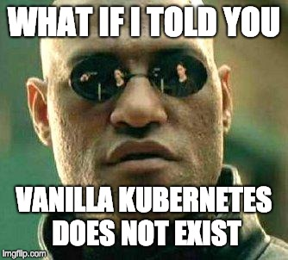
VANILLA KUBERNETES IS NOT A THING
In practice, no vendor distribution of Kubernetes is “Vanilla”

Slide 30
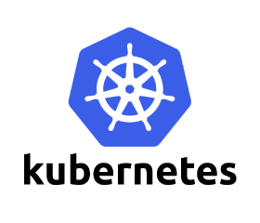
Kubernetes Core Platform Components
DEPLOYMENT STRATEGIES
ORCHESTRATION
CLUSTER SERVICES
SECURITY
STORAGE
NETWORK
Notes:
Slide takeaway: Installing Kubernetes and playing around with it for many is not a big issue, but establishing Kubernetes as the platform for the enterprise to run business critical applications takes a lot more.
While it actually is not that hard to download and install Kubernetes, getting it really ready for production to run business critical applications for an enterprise takes a lot lot more. There are a number of things that need to be pieced together, tested and hardened for operations.
For example, just take identity management. With Kubernetes, you will be providing access to critical internal systems to employees, partners, and customers. You need to adhere to the security rules established in the company, the way to do that is to write an integration between Kubernetes and your company’s approved LDAP. That requires knowledge of Dex, the open source identity system, Kubernetes and integration systems to LDAP. Similarly, you’ll need to hook up Prometheus, open source monitoring and alerting or hook up another monitoring system so you can get full visibility into your Kubernetes operations in testing and production.

Slide 31
What’s needed to put Kubernetes into production?
Cluster services monitoring, showback, registry, logging
Application services
middleware, functions, ISV
Developer services
dev tools, automated builds, CI/CD, IDE
Lacks many essential components
Operating system
Developer tooling and UX
Container runtime (CRI-O, Containerd, Docker, etc).
Image registry
Software-defined networking
Load‐balancer and routing
Log management
Container metrics and monitoring
DNS
Ingress
RBAC
11
10
Service mesh
3
6
7
4
5
8
9
2
Automated operations
certified
Enterprise Linux
1
The customer (or third-party) must configure, integrate, operate and support additional components to be fully operational.
Notes:
Slide takeaway: Installing Kubernetes and playing around with it for many is not a big issue, but establishing Kubernetes as the platform for the enterprise to run business critical applications takes a lot more.
While it actually is not that hard to download and install Kubernetes, getting it really ready for production to run business critical applications for an enterprise takes a lot lot more. There are a number of things that need to be pieced together, tested and hardened for operations.
For example, just take identity management. With Kubernetes, you will be providing access to critical internal systems to employees, partners, and customers. You need to adhere to the security rules established in the company, the way to do that is to write an integration between Kubernetes and your company’s approved LDAP. That requires knowledge of Dex, the open source identity system, Kubernetes and integration systems to LDAP. Similarly, you’ll need to hook up Prometheus, open source monitoring and alerting or hook up another monitoring system so you can get full visibility into your Kubernetes operations in testing and production.

Slide 32
Kubernetes and Container Platform
CONTAINER
CONTAINER
CONTAINER
CONTAINER
CONTAINER
SELF-SERVICE
SERVICES
SERVICE CATALOG
DEPLOYMENT STRATEGIES
BUILDS
DEPLOYMENTS
APPLICATION LIFECYCLE AUTOMATION
ORCHESTRATION
CLUSTER SERVICES
ORCHESTRATION
CLUSTER SERVICES
SECURITY
STORAGE
NETWORK
SECURITY
TELEMETRY
STORAGE
NETWORK
REGISTRY
PACKAGING FORMAT
Container OS (Red Hat CoreOS, Amazon Bottlerocket Linux, Google Container-Optimized OS)
PHYSICAL
VIRTUAL
PRIVATE
PUBLIC
Notes:
Slide takeaway: Installing Kubernetes and playing around with it for many is not a big issue, but establishing Kubernetes as the platform for the enterprise to run business critical applications takes a lot more.
While it actually is not that hard to download and install Kubernetes, getting it really ready for production to run business critical applications for an enterprise takes a lot lot more. There are a number of things that need to be pieced together, tested and hardened for operations.
For example, just take identity management. With Kubernetes, you will be providing access to critical internal systems to employees, partners, and customers. You need to adhere to the security rules established in the company, the way to do that is to write an integration between Kubernetes and your company’s approved LDAP. That requires knowledge of Dex, the open source identity system, Kubernetes and integration systems to LDAP. Similarly, you’ll need to hook up Prometheus, open source monitoring and alerting or hook up another monitoring system so you can get full visibility into your Kubernetes operations in testing and production.

Slide 33


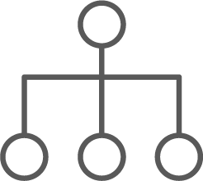

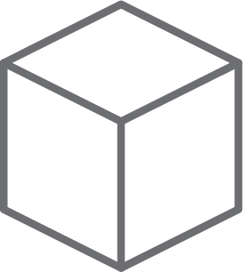

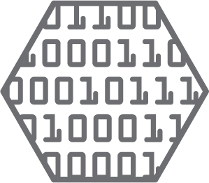
dev and ops via web, cli, API, and IDE
OPENSHIFT CONTAINER PLATFORM | Architectural Overview
MASTER
WORKER
WORKER
OpenShift Services
Kibana | Elasticsearch
Kibana | Elasticsearch
SCM
(GIT)
Infrastructure
services
Registry
Registry
Kubernetes
services
Router
Router
Developers
CI/CD
Prometheus | Grafana Alertmanager
Prometheus | Grafana Alertmanager
etcd
EXISTING AUTOMATION TOOLSETS
Monitoring | Logging | Tuned SDN | DNS | Kubelet
Monitoring | Logging | Tuned SDN | DNS | Kubelet
Admins
COMPUTE
NETWORK
STORAGE
Notes:
Regardless of whether a consumer is an administrator or a developer, a rich set of web, CLI, and IDE integrations, all made possible by the Kubernetes and OpenShift APIs, means that people can work in the way they are most comfortable.

Slide 34
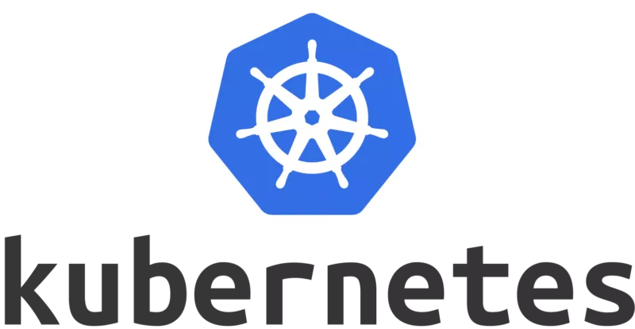


A world without OpenShift
Who
must manage against lowest common denominator in a rapidly changing ecosystem
X
Rationalizing multiple cloud provider specific xKx service versions (k8s-based offerings)
(storage compat, networking, projects supported, etc.)
X
Base OS Updates
(matching OS dependencies in Linux distribution to cloud provider specific implementation)
(~90 day release cycle)
Cloud provider specific updates, patches, CVE remediation, etc. ->
+...
AWS
EKS
Google
GKE
Azure
AKS
Alibaba
CSK
Additional Cloud providers (Rackspace, IBM/Softlayer, Huawei, Tencent, etc.)
Private Cloud
DIY
No compatibility or version guarantees - each xKx version will be unique, & evolve uniquely
Notes:
If you use a kubernetes and container implementation that is not Red Hat’s OpenShift Container Platform, what will that mean?
As we said before, Kubernetes is really just the interface into Linux in a cluster deployment (in container terminology).
So, Every Kubernetes Service is also a Linux Service
So, if you want to enable your containers to run predictably, and at an enterprise level of production support quality level, on all these kubernetes services, you have to figure out
A.) Does my container run on this service (they may have different kernel features, etc.)
B.) How do I account for the Change at this level too?
Kubernetes is a fast moving technology. Lots of change. Releases every 90 days
How will the KaaS providers manage their updates?
What do the providers add to k8s?
What do they not use from k8s?
So, change is constant:
Base OS
Kubernetes releases
KaaS provider additions and changes

Slide 35
How OpenShift Platform Enhances Kubernetes for Developers
Extra services that a developer or administrator needs

Slide 36
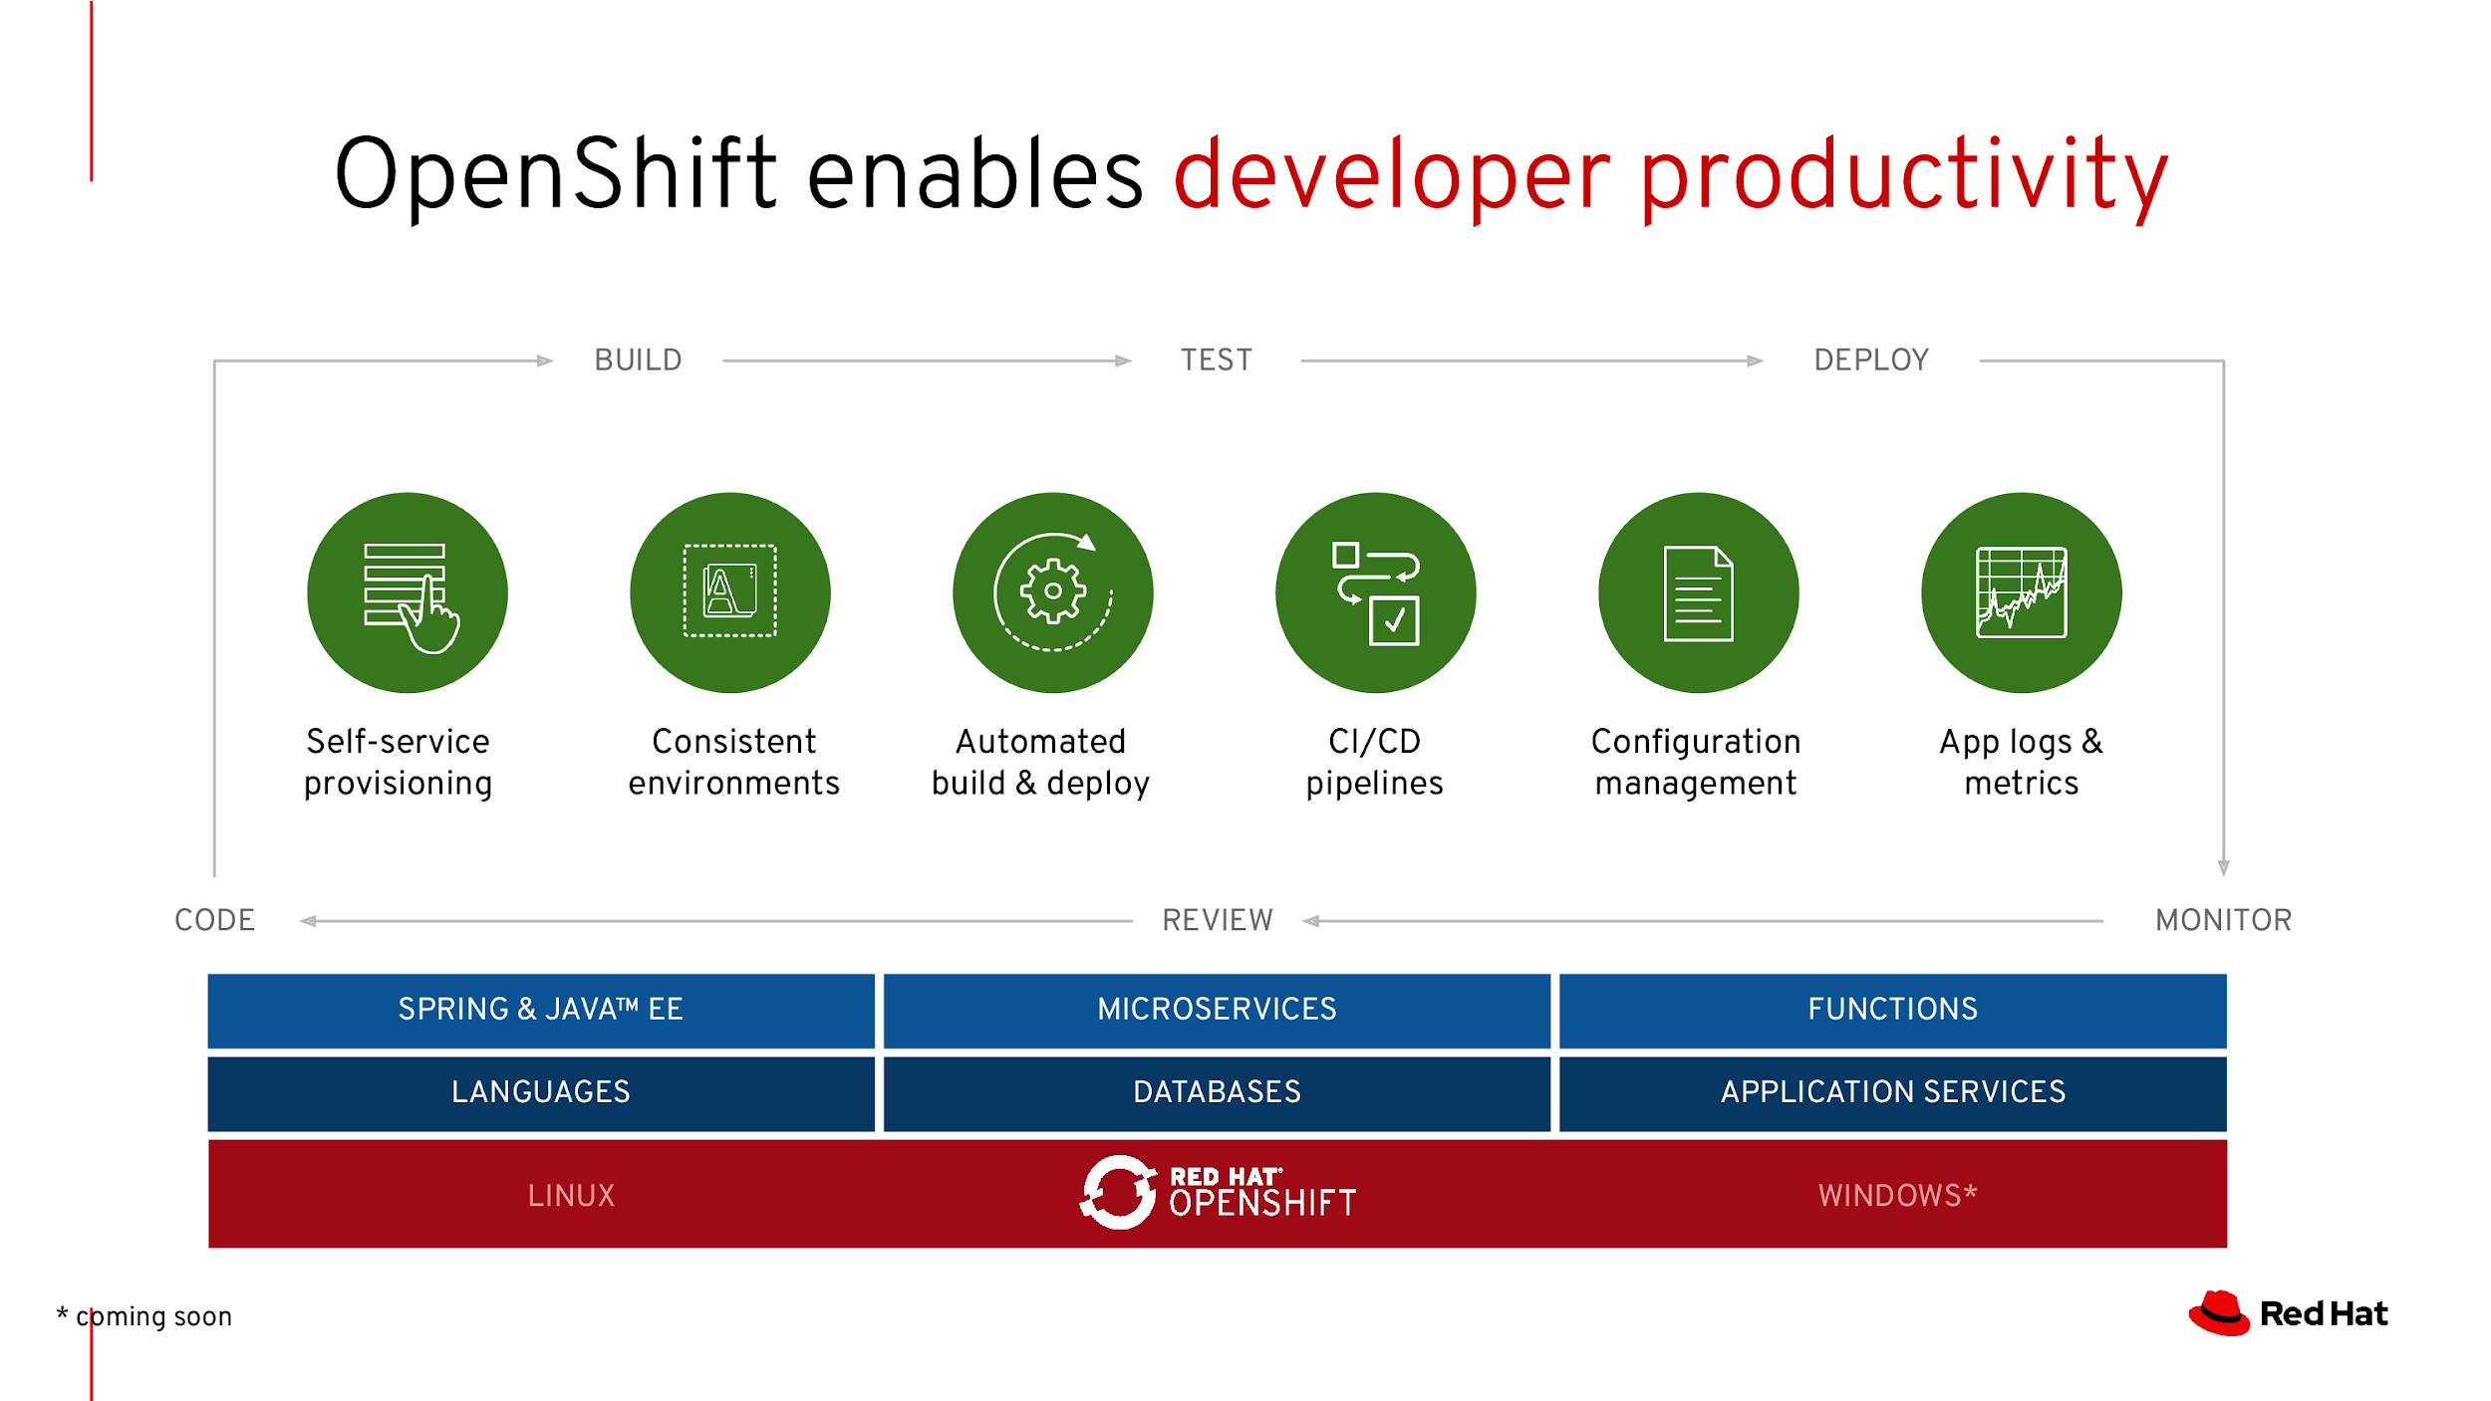
CLOUD & CONTAINER NATIVE ROADSHOW - DEVELOPER TRACK
CLOUD & CONTAINER NATIVE ROADSHOW - DEVELOPER TRACK

Slide 37
CLOUD & CONTAINER NATIVE ROADSHOW - DEVELOPER TRACK
OpenShift Developer Services
IDE
DEV CONSOLE
DEV CLI
BUILDS
CI/CD
Eclipse Che, VSCode, IntelliJ and Eclipse IDE provide web-based and desktop IDEs integrated with OpenShift and Kubernetes
Developer and application-centric web console for interacting with OpenShift
Developer CLI to provide an application-centric way of interacting with OpenShift
Automated and secure image builds from application source code, binary or Dockerfile
Continuous delivery pipelines optimized for Kubernetes (via the Tekton project)
Enabling developer productivity to build and deploy apps on Kubernetes

Slide 38


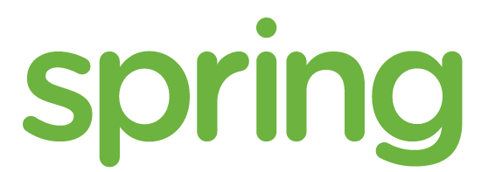


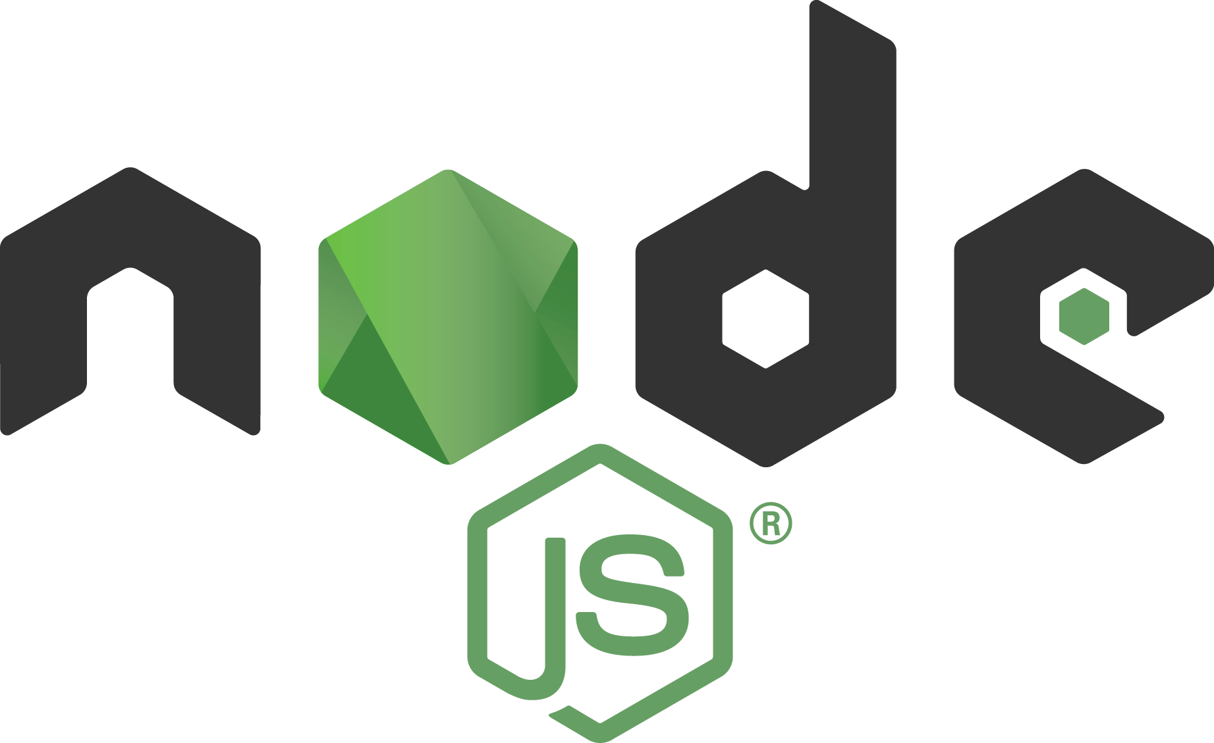


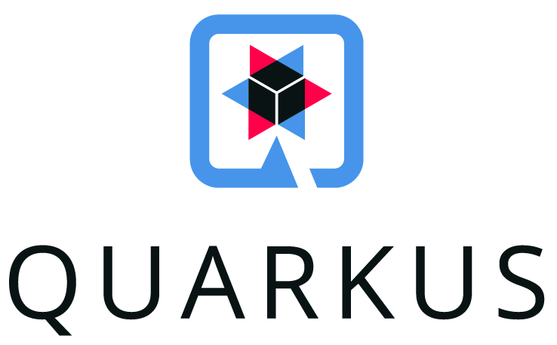


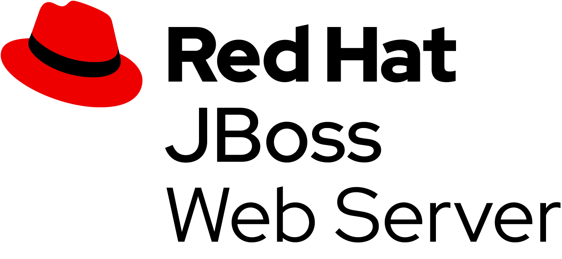
Runtimes & Languages Support
ENTERPRISE JAVA
SPRING APPS
JAVA MICROSERVICES
JAVASCRIPT FLEXIBILITY
REACTIVE SYSTEMS
TOMCAT SIMPLICITY

Slide 39
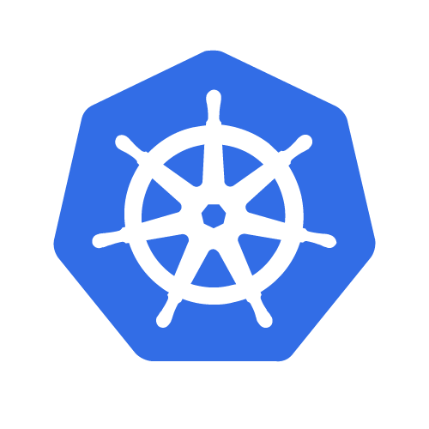

“MODERN” JAVA APP STACK
MONOLITHS, MICROSERVICES
SINGLE APP
DAYS OF LIFE
100s MB RAM
SECONDS TO START
QUARKUS
MICROSERVICES, SERVERLESS
SINGLE APP
SECONDS TO DAYS OF LIFE
10s MB RAM
MILLISECONDS TO START
App
Dynamic Application Frameworks
App
Application Server
Optimized Application Frameworks
Java Virtual Machine (Hotspot)
Java Virtual Machine (Hotspot)
Optional

Slide 40


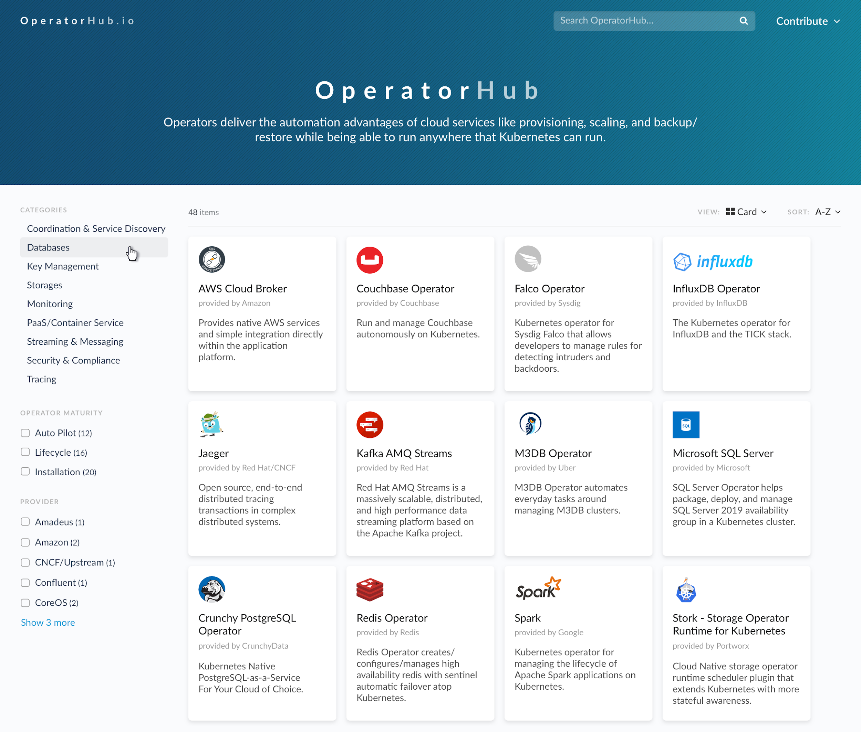
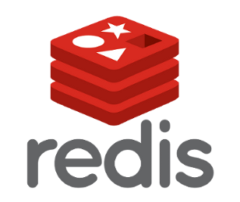




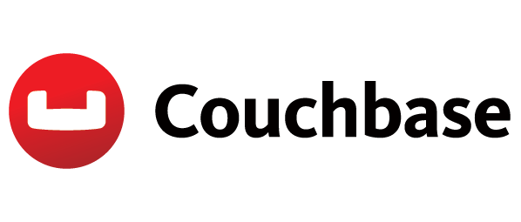

Service Catalog through OperatorHub
For Administrators - Provide Controlled Self-Service Capabilities
Discover and install optional components and apps
Lower barrier to entry
Don’t have to be an expert in a technology

Slide 41
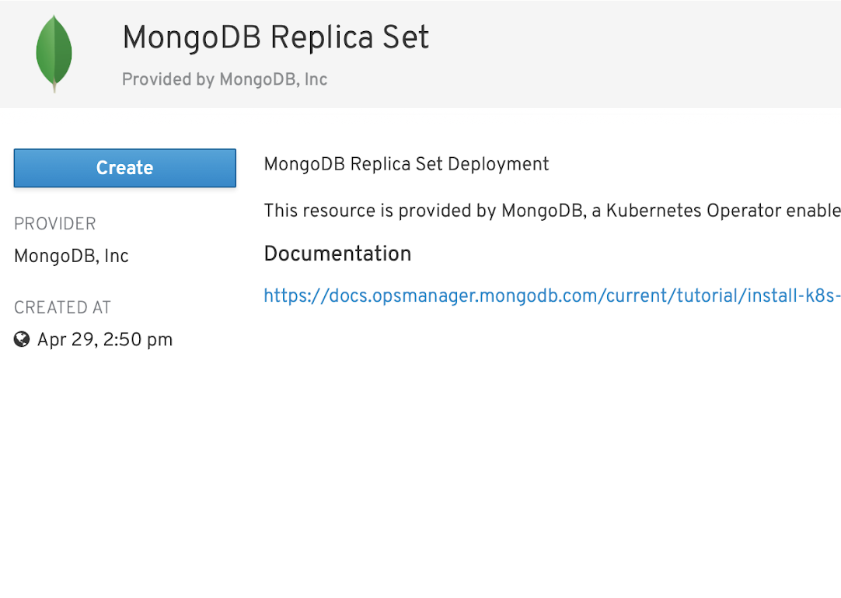
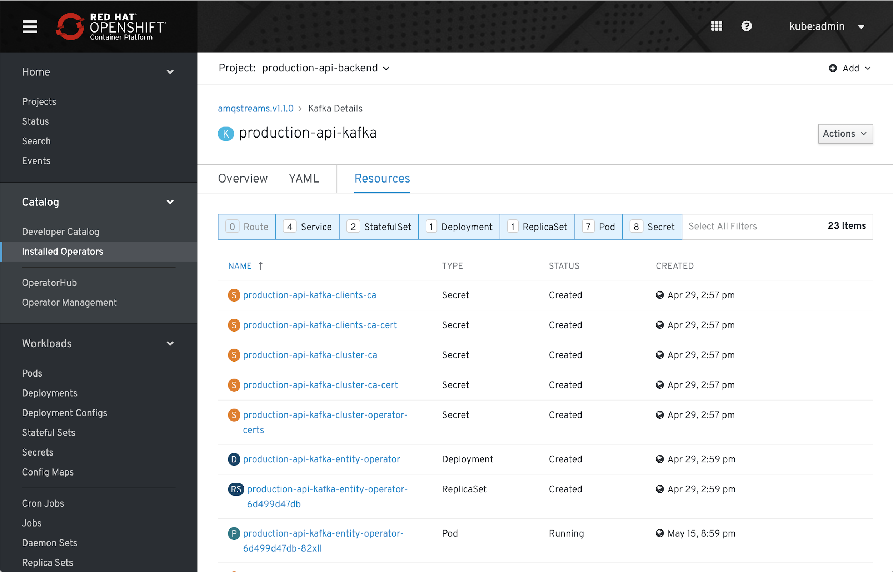
Self-service for developers
For Developers - Improve User Experience
apiVersion: mongodb.com/v1
kind: MongoDbReplicaSet
metadata:
name: example
namespace: production
spec:
members: 3
version: 4.0.2
persistent: false
project: example
credentials: my-secret

Slide 42
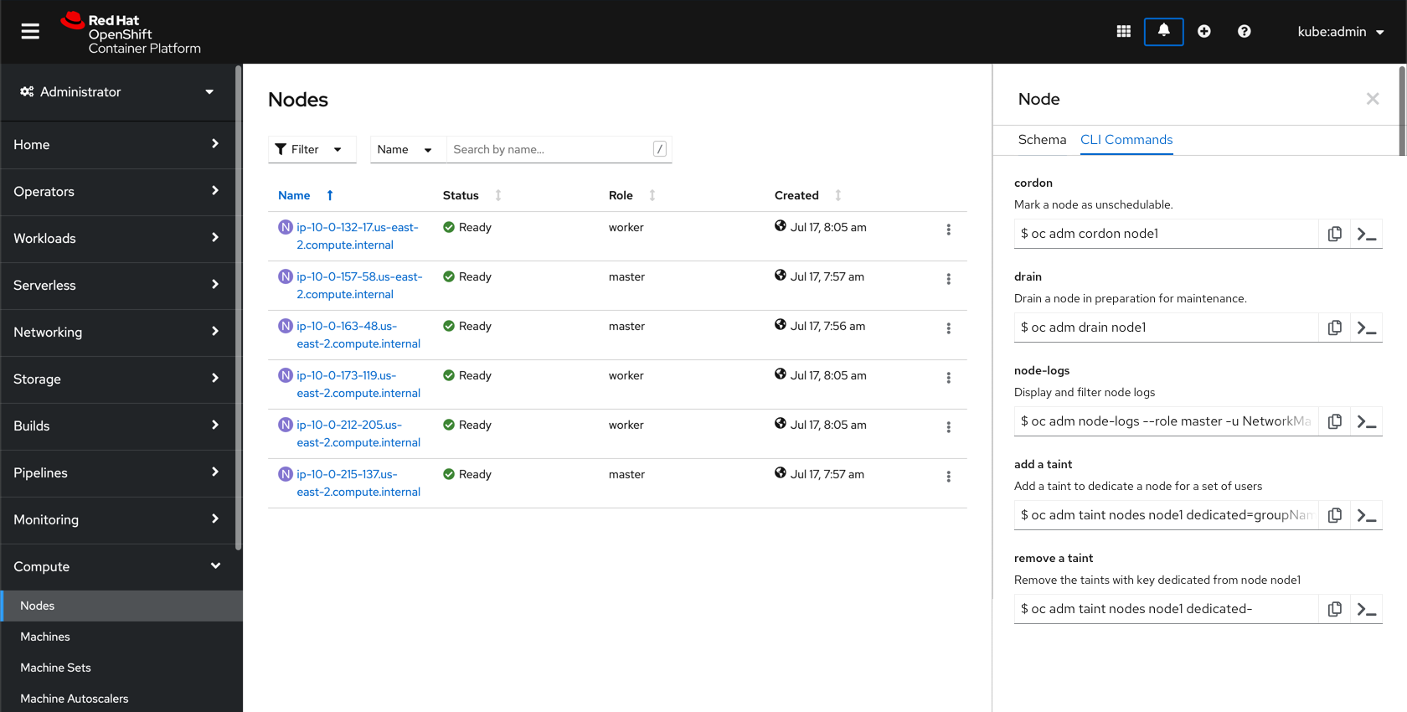
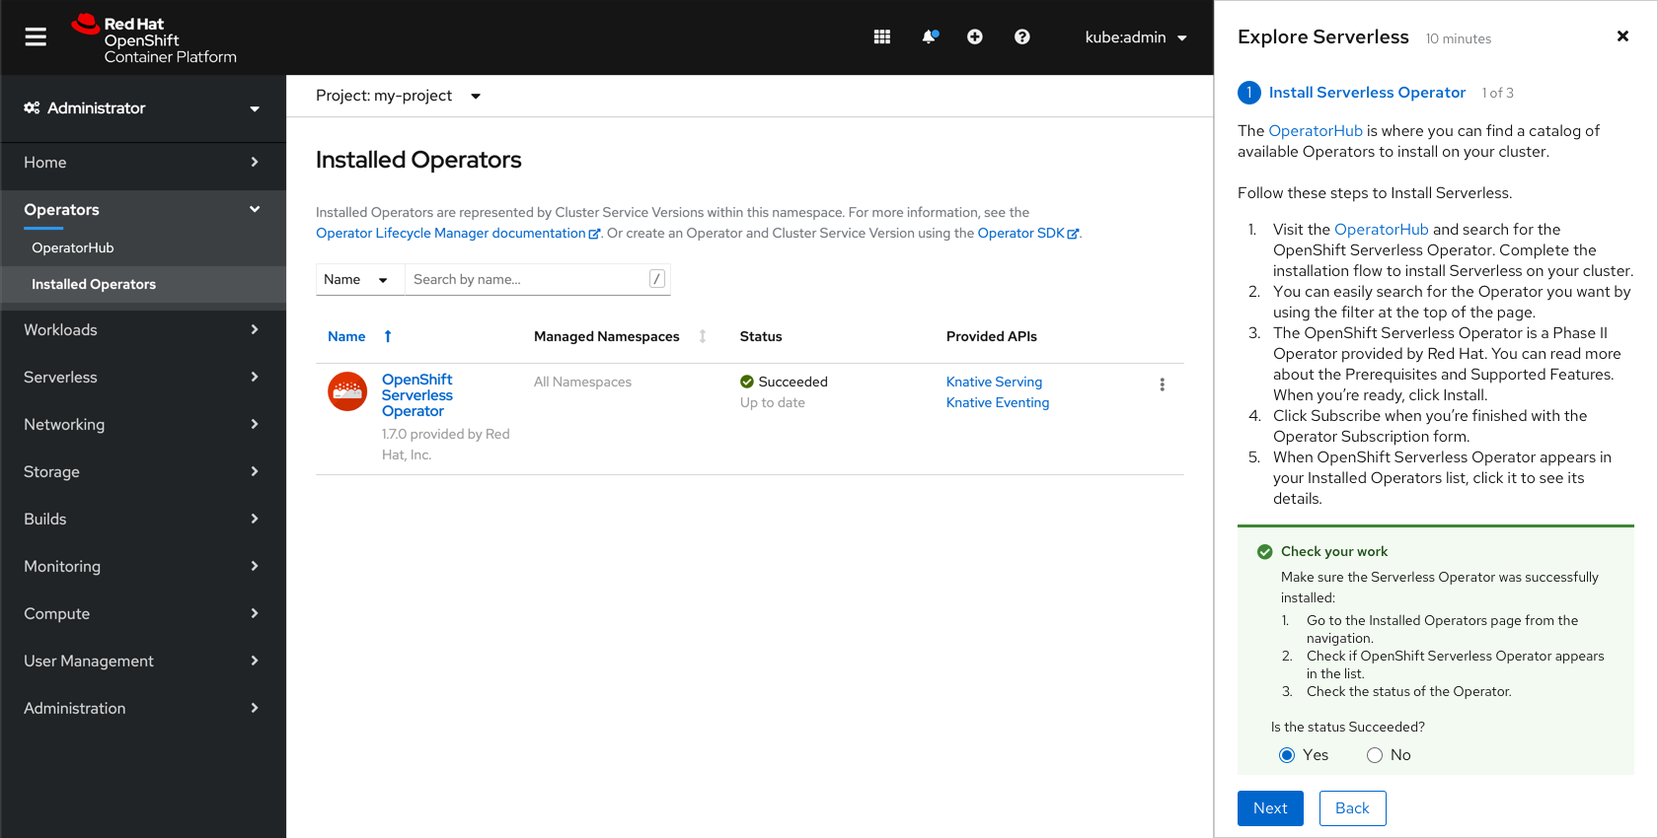
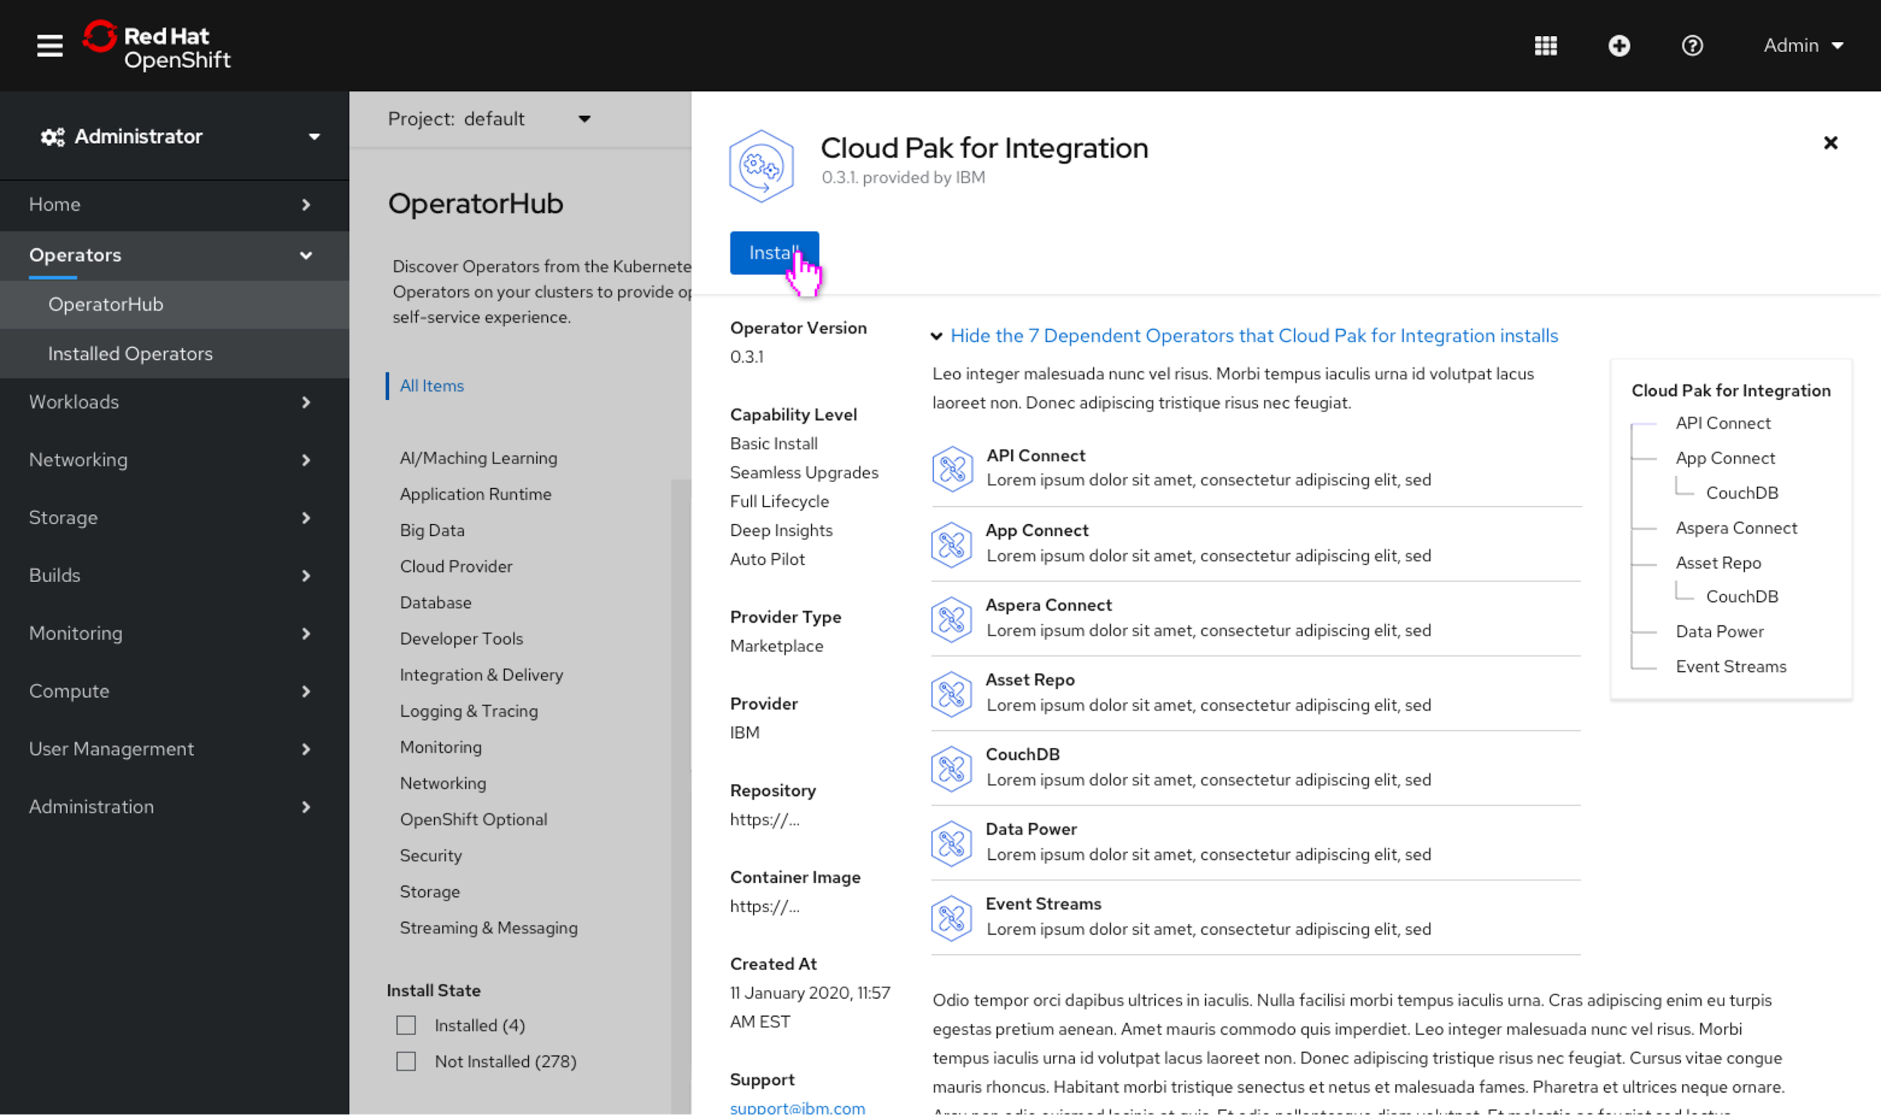
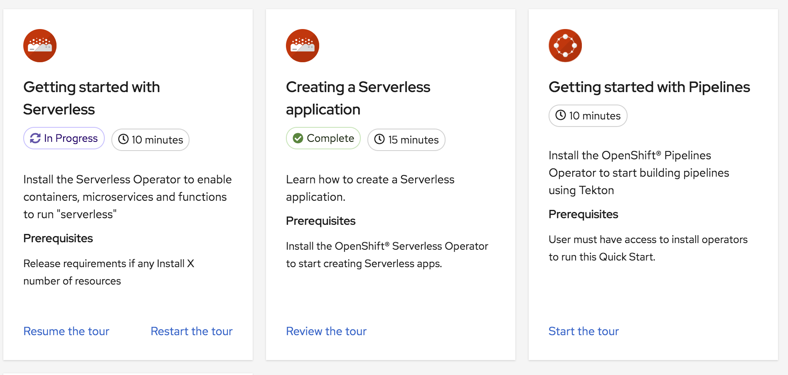
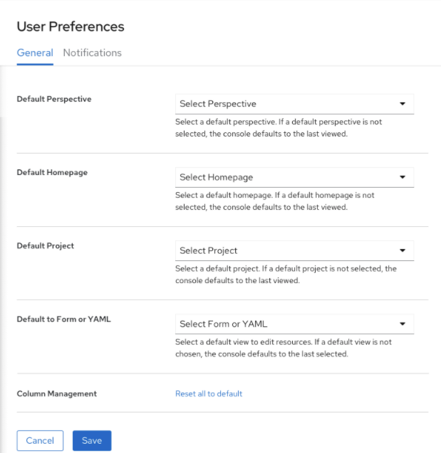
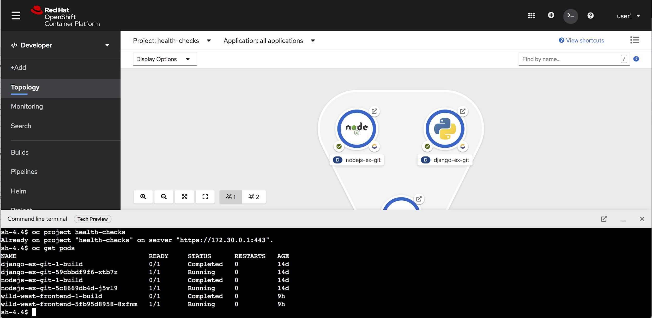
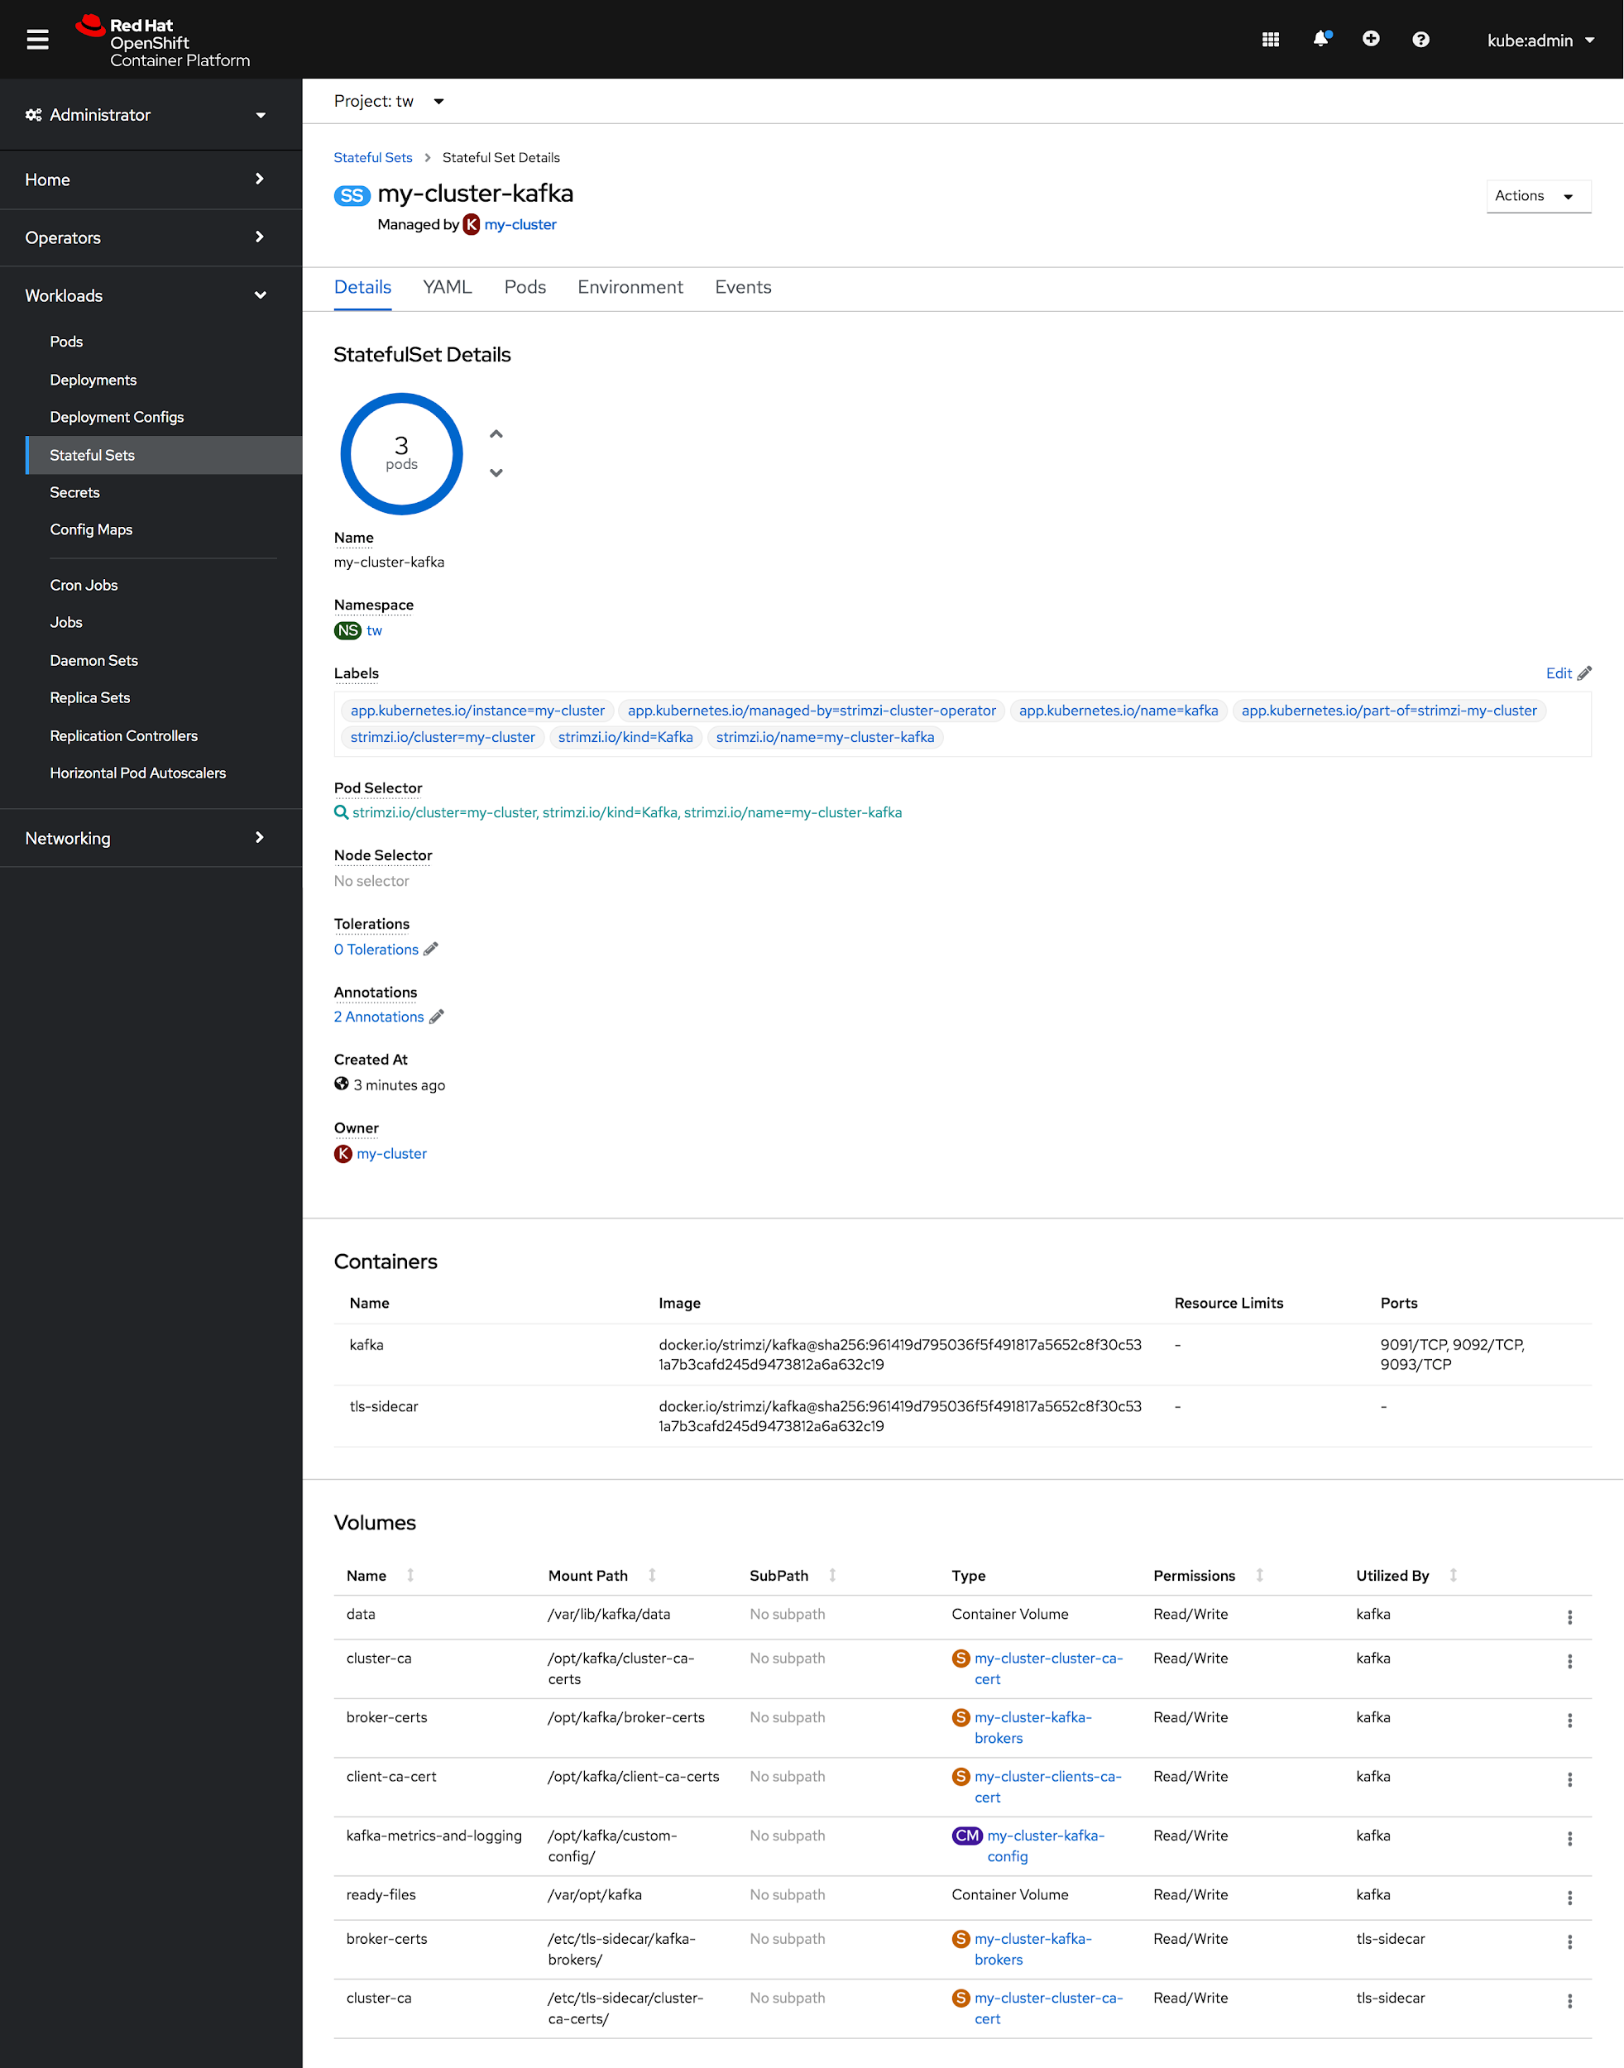
First-class Console Experience
Developing on Kubernetes
LEARNING Kubernetes
MANAGING Kubernetes
EXTENDING Kubernetes
Application Monitoring
Serverless Eventing ( Camel-K + Custom )
GitOps Dashboard
Quick Starts
Admin Checklist
CLI Shortcuts + Web Terminal
Column Management
User Preferences
Internationalization (I18N), Accessibility (A11Y) Support
Dynamic Plugin Support
Quick Starts Extensions (CRD)
Declarative Operator UI
Notes:
Speaker : Serena Nichols

Slide 43



OPENSHIFT MONITORING | Solution Overview
OpenShift Cluster Monitoring
Metrics collection and storage via Prometheus, an open-source monitoring system time series database.
Alerting/notification via Prometheus’ Alertmanager, an open-source tool that handles alerts send by Prometheus.
Metrics visualization via Grafana, the leading metrics visualization technology.

Slide 44
OPENSHIFT MONITORING | Prometheus, Grafana and Alertmanager Wiring
Grafana
Prometheus
Alertmanager
Control Plane (API)
kube-state-metrics
node-exporter
node-exporter
Node (kubelet)
Node (kubelet)
Infra/Worker (“hardware”)
Worker (“hardware”)

Slide 45
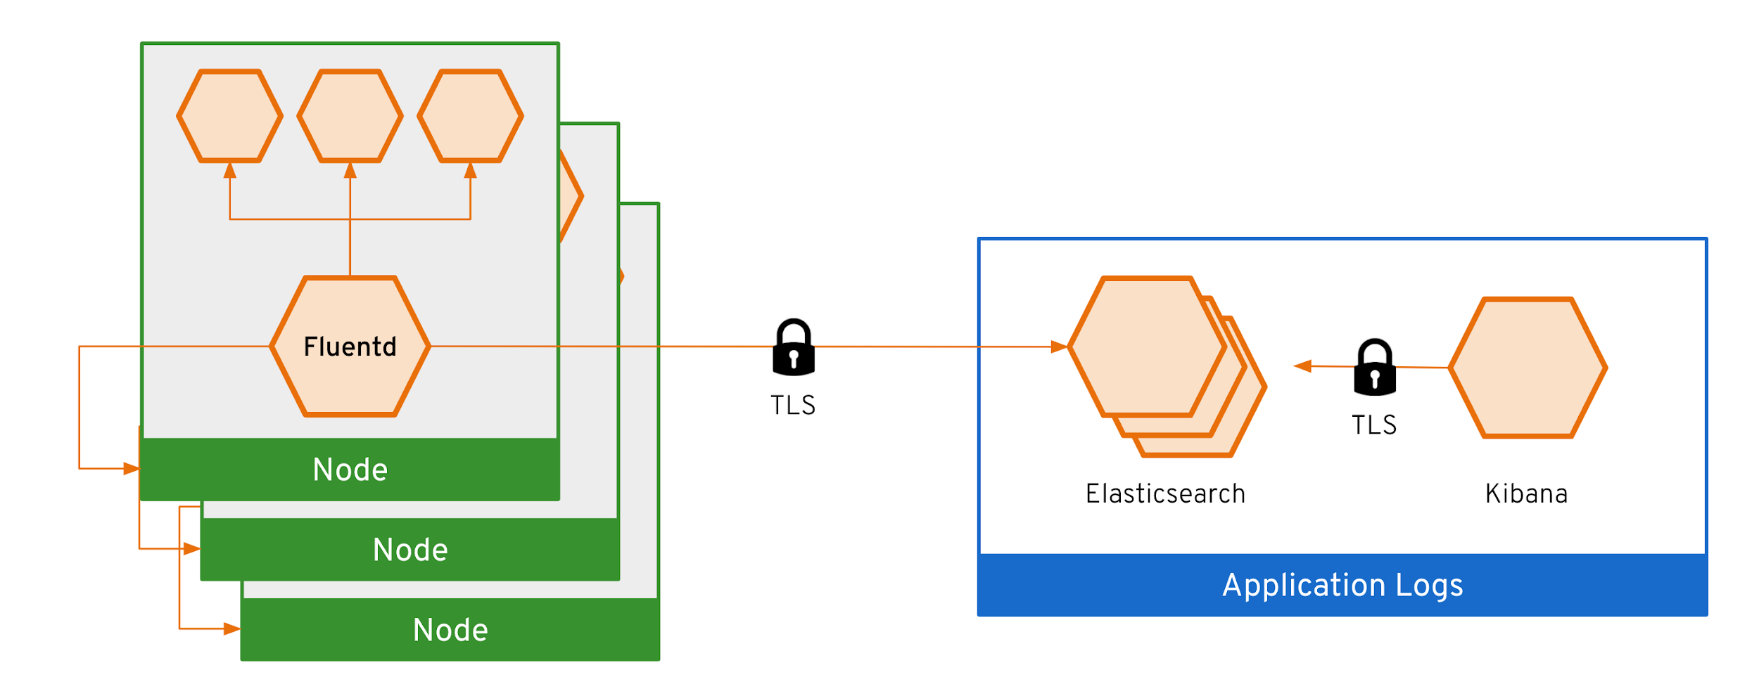
Observability via log exploration and corroboration with EFK
OPENSHIFT LOGGING | Solution Overview
Components
Elasticsearch: a search and analytics engine to store logs
Fluentd: gathers logs and sends to Elasticsearch.
Kibana: A web UI for Elasticsearch.
Access control
Cluster administrators can view all logs
Users can only view logs for their projects
Ability to forward logs elsewhere
External elasticsearch, Splunk, etc

Slide 46
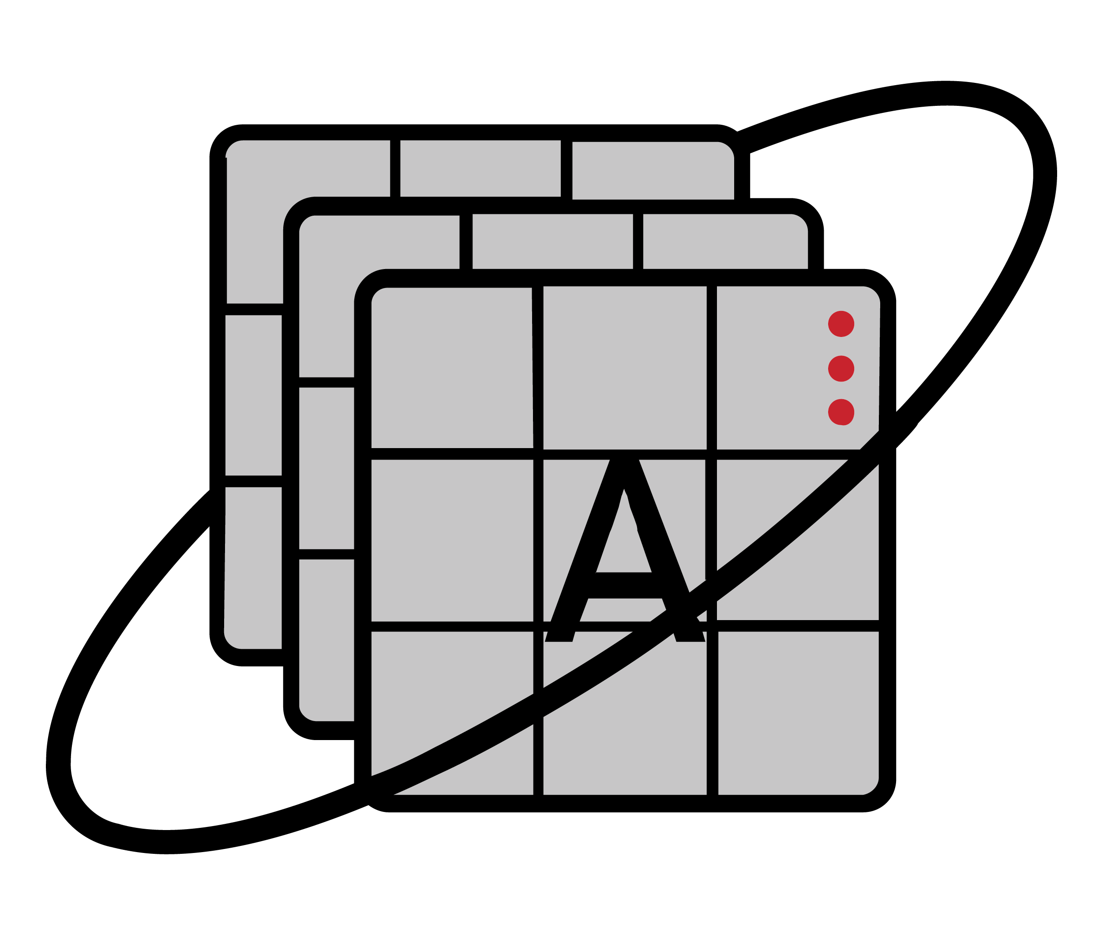

Service Monitoring Maturity Model
3
Level 3: Custom instrumentation of service (logged in users, unprocessed orders, etc) - “White Box”
2
Level 2: Runtime instrumentation (eg: JVM, app server, response time, etc) - “Black Box”
Service Monitoring Maturity
1
Level 1: Simple insights into utilization (CPU and Memory) [of pods].
0
Level 0: Up/Down Red/Green monitoring.
Notes:
There are many aspects of applications that can and should be monitored.
Basic monitoring is provided by the underlying container platform (OCP), including metrics for pods, nodes, etc. This is limited in that there is no metrics for application behavior, other than raw memory and cpu usage. But this is often “good enough”
Going further, specific application runtimes and application behavior can be monitored, often requiring instrumentation which goes beyond simple memory/cpu.
For example JVM metrics, or even application-specific metrics like Database metrics, logged-in user information, how many orders are outstanding in a retail application, etc.

Slide 47
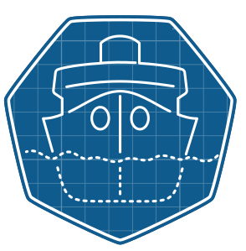
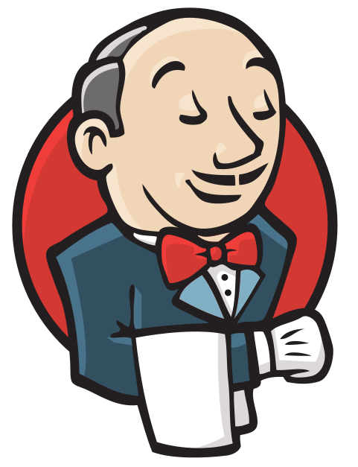




A Comprehensive DevOps Platform for Hybrid Cloud
Build container images from source code using Kubernetes tools
Traditional and Kubernetes-native CI/CD
Declarative GitOps for multi-cluster continuous delivery
OpenShift Builds
OpenShift Pipelines
OpenShift GitOps
OpenShift
Product Manager: Siamak Sadeghianfar

Slide 48












OpenShift Service Mesh
Connect, Secure, Control and Observe Services on OpenShift
Services
A software infrastructure layer between Kubernetes and your services for managing communications.
Handles common “microservice” challenges, so that developers don’t have to:
Security
Monitoring & Observability
Application Resilience
Upgrades, Rollouts & A/B Testing
And more…
F
Envoy
Envoy
Envoy
OpenShift Service Mesh
Istio
Kiali
Jaeger
OPENSHIFT
Red Hat Enterprise Linux CoreOS
Product briefing deck
Physical
Virtual
Private cloud
Public cloud
Product Manager: Jamie Longmuir and Mauricio "Maltron" Leal
* Eventing is currently in Technology Preview
** Functions are currently a work in progress initiative
Notes:
Product Manager: Jamie Longmuir, Mauricio “Maltron” Leal
Summary:
OpenShift Service Mesh provides a layer on top of Openshift for securely connecting services in a uniform manner that provides centralized security, control and observability across a system of services. This is achieved by connecting applications using lightweight Envoy proxies to form a mesh of communications - a “Service mesh”.
Diving Deeper:
The ability to centrally view and manage service interactions provides multiple benefits, including:
The ability to enforce zero-trust networking, where services must opt-in to be able to communicate with each other.
Automatically encrypt communications with mTLS, authentication and authorization.
Fine grain control of service traffic, enabling a range of deployment options, A/B testing, chaos and failure engineering, and many more scenarios.
Visibility into service communication with out of the box distributed tracing, metrics and logging.
OpenShift Service Mesh is based on the Istio open source project with the Kiali management Console. Distributed, monitoring and metrics are provided by the open source projects Jaeger, Grafana and Prometheus. This ensures that you don't suffer with lock-in concerns and can still get the innovation from a growing open source community.

Slide 49
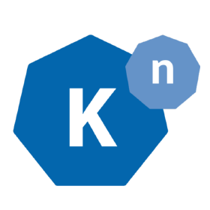
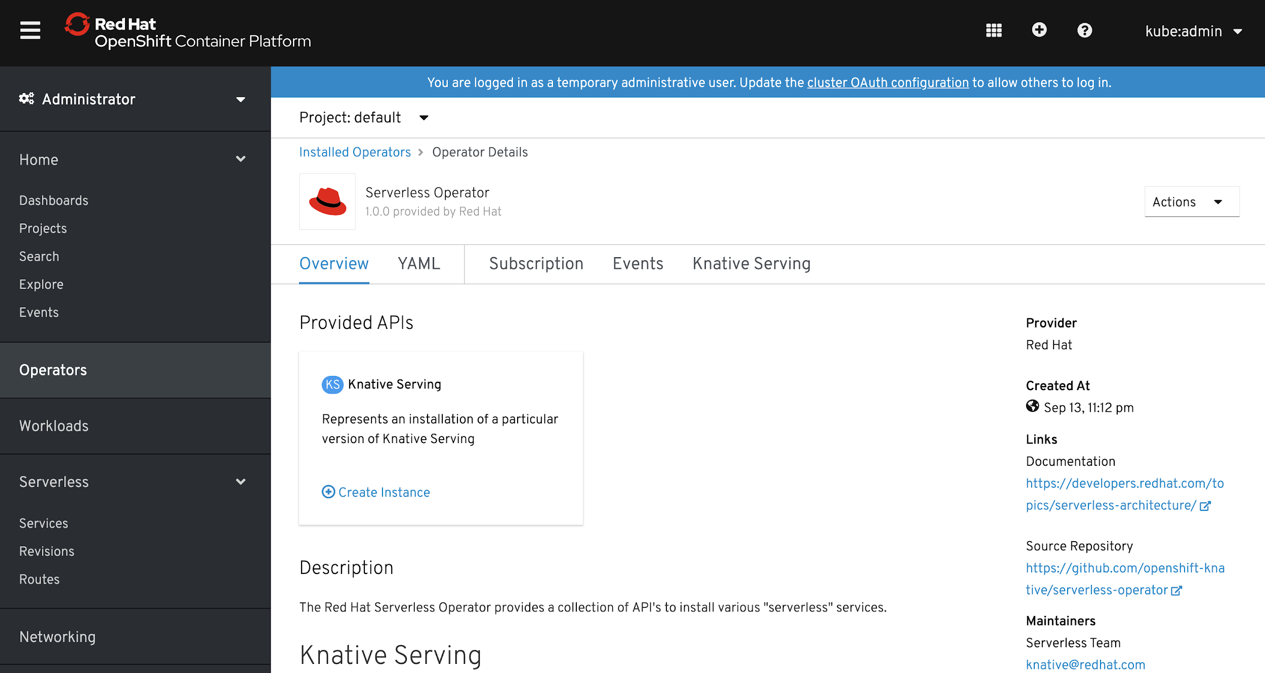
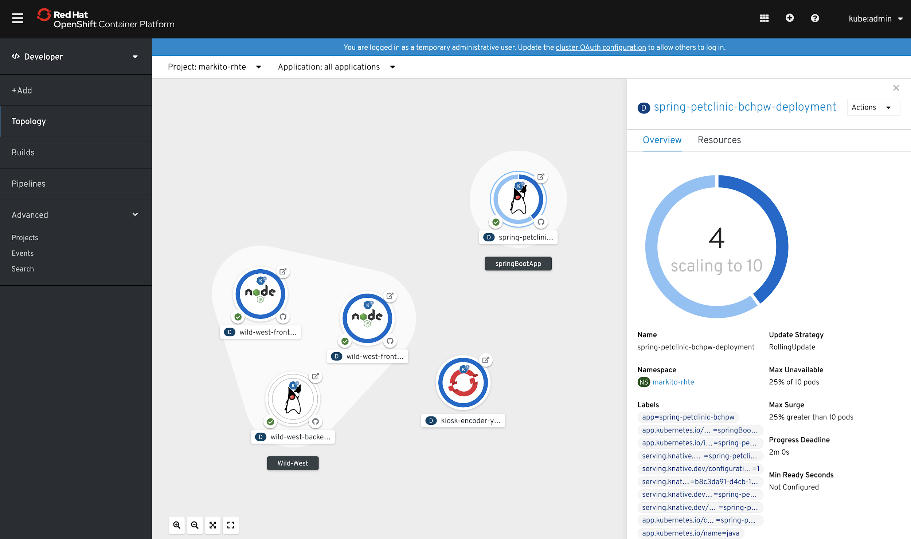
OpenShift Serverless
Key Features
Familiar to Kubernetes users. Native.
Scale to 0 and autoscale to N based on demand
Applications and functions. Any container workload.
Powerful eventing model with multiple event sources.
Operator available via OperatorHub
Knative v0.7.1 (v1beta1 APIs)
No vendor lock in
Key Benefits
https://openshift.com/learn/topics/serverless https://redhat-developer-demos.github.io/knative-tutorial
Notes:
OpenShift Serverless is available as a tech preview, allowing OpenShift customers to start deploying serverless applications. This feature is based on the Knative project and enables individual containers to start and scale on demand in response to an event, the return to zero when not in use.
KEDA vs. Knative:

Slide 50
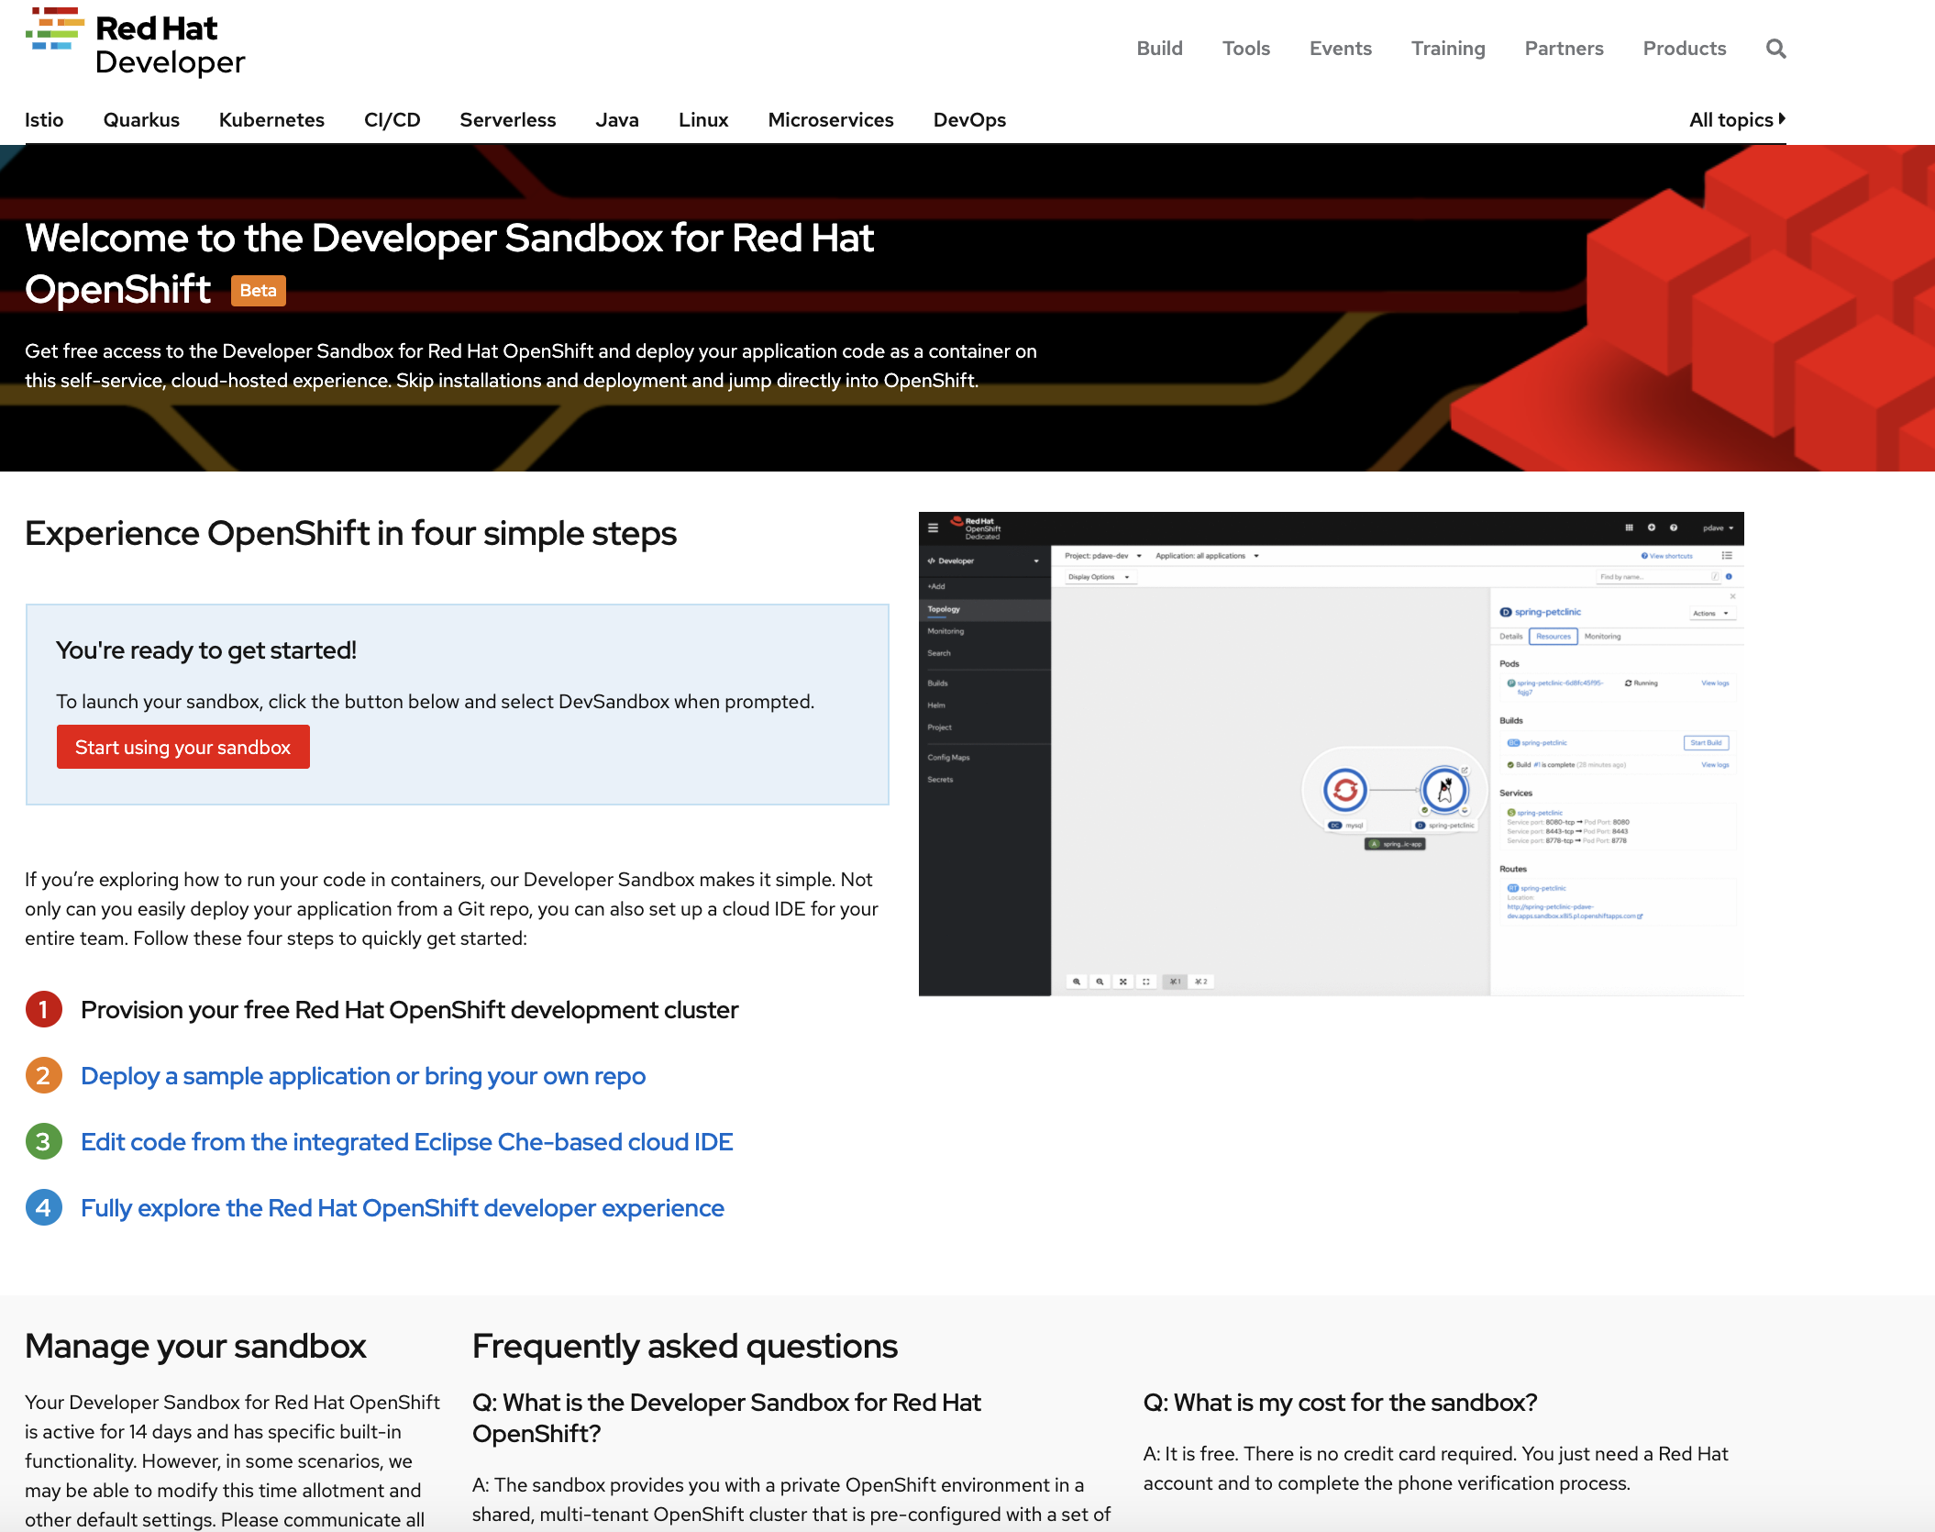

Developer Sandbox for OpenShift
Self-service, private OpenShift environment with native developer experience
**NEW**
Shared cluster multi-tenant
14 days
Limited privileges
10 vCPU, 8 GB RAM
3 projects
OOTB tools, App Svcs
Dev Sandbox
https://developers.redhat.com/developer-sandbox
Product Manager: Parag Dave
Notes:
Speaker: David Harris
Developer Sandbox for OpenShift reduces friction for developers by instantly providing a reasonably sized, private OpenShift environment for creating and deploying apps of their choice - at zero cost. Developers can fully explore the default developer experience that comes out-of-the-box with OpenShift. Developers can take their source code and see how easy it is to deploy them as container images. Developers can create new Quarkus-based applications, connect them with a database running in their private environment, and send links to their team members to provide feedback on their application as they iterate through it jointly.

Slide 51
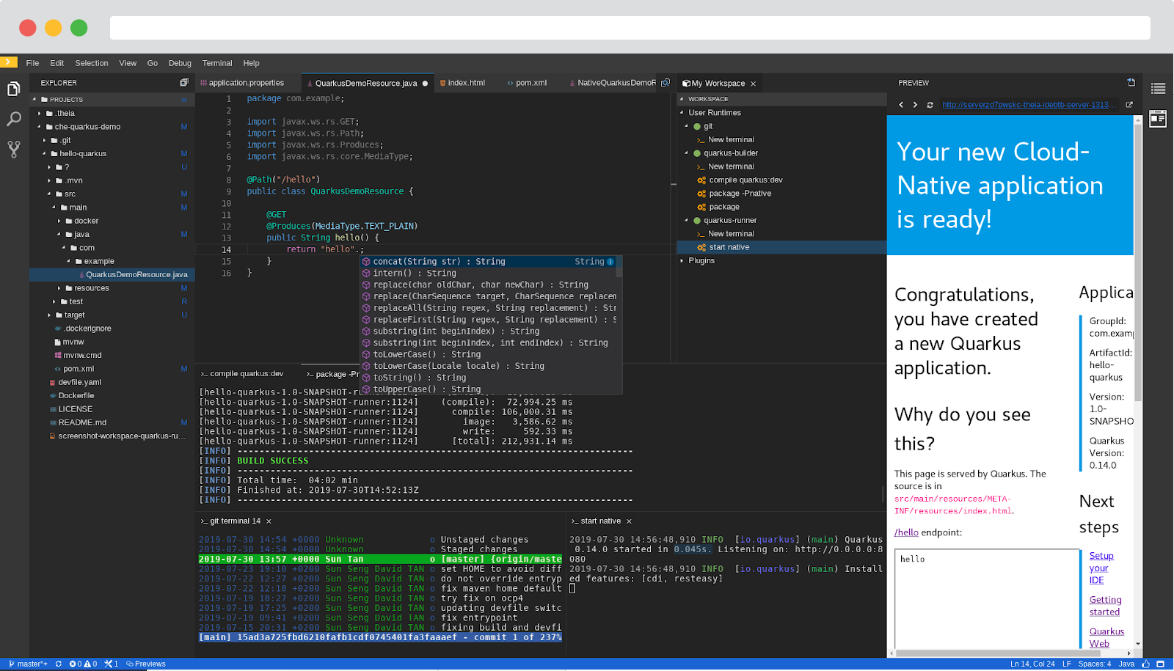
CodeReady Workspaces 2.0
CODEREADY WORKSPACES 2
Based on Eclipse Che 7
Kubernetes-based developer workspaces: Leverage fully containerized developer workspaces, and bring your kubernetes application runtime in your development environment.
New Editor: Get a top-of-the-art desktop like experience in the browser.
VSCode extension compatibility: Benefits from existing extensions
Devfile: Codified definition of replicable developer environments
OpenShift VSCode Plug-in: Speeds up OpenShift development
Easier to Monitor and Operate: Prometheus and Grafana dashboards.

Slide 52
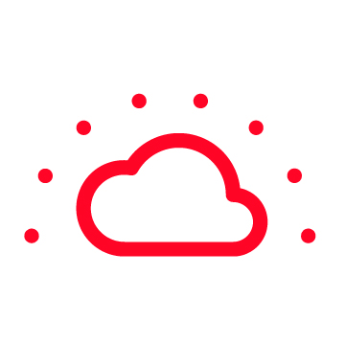


Draw Me a Picture!
Multi-cluster Management Creation ⠇Discovery ⠇Policy ⠇Compliance ⠇Configuration ⠇Workloads
Manage Workloads
Build Cloud-Native Apps
Developer Productivity
Platform Services
Application Services
Developer Services
OpenShift Container Platform
Service Mesh ⠇Serverless Builds ⠇CI/CD Pipelines
Full Stack Logging Chargeback
Databases ⠇Languages Runtimes ⠇Integration Business Automation 100+ ISV Services
Developer CLI ⠇VS Code extensions ⠇IDE Plugins Code Ready Workspaces CodeReady Containers
Cluster Services Automated Ops ⠇Over-The-Air Updates ⠇Monitoring ⠇Registry ⠇Networking ⠇Router ⠇KubeVirt ⠇OLM ⠇Helm
OpenShift Kubernetes Engine
Kubernetes
Red Hat Enterprise Linux & RHEL CoreOS
Edge
Physical
Virtual
Private cloud
Multi-Arch
Public cloud
Managed cloud
(Azure, AWS, IBM, Google)

Slide 53
Demo

Slide 54
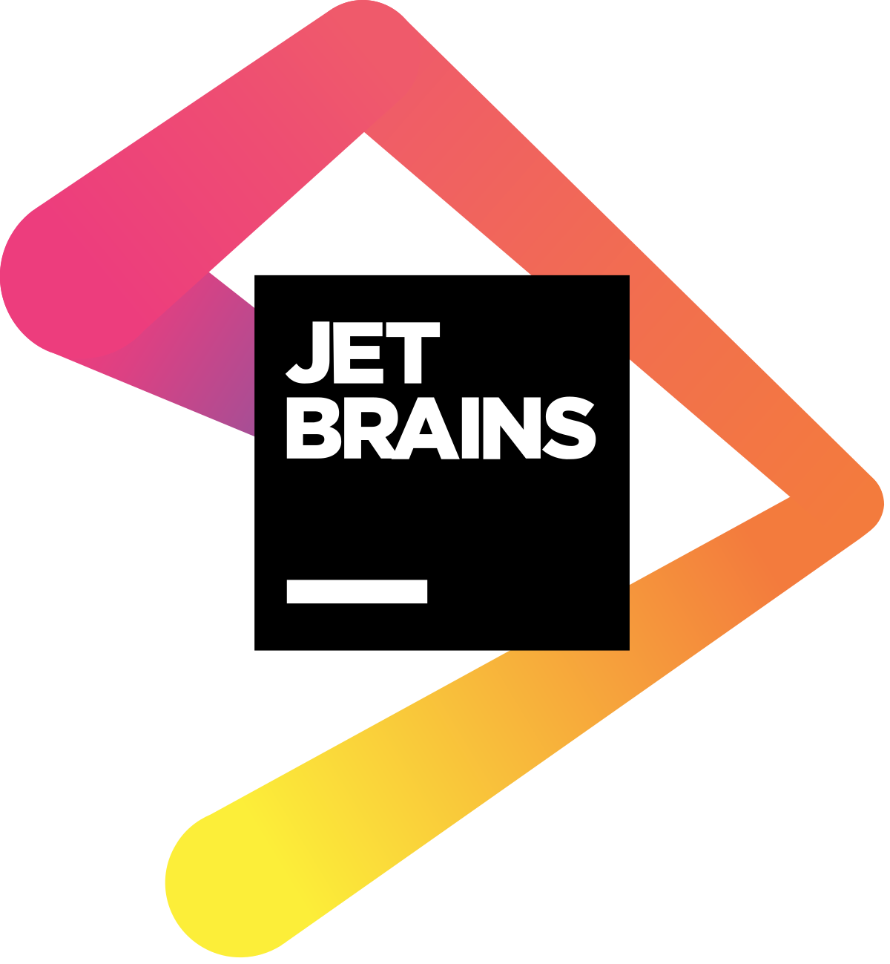

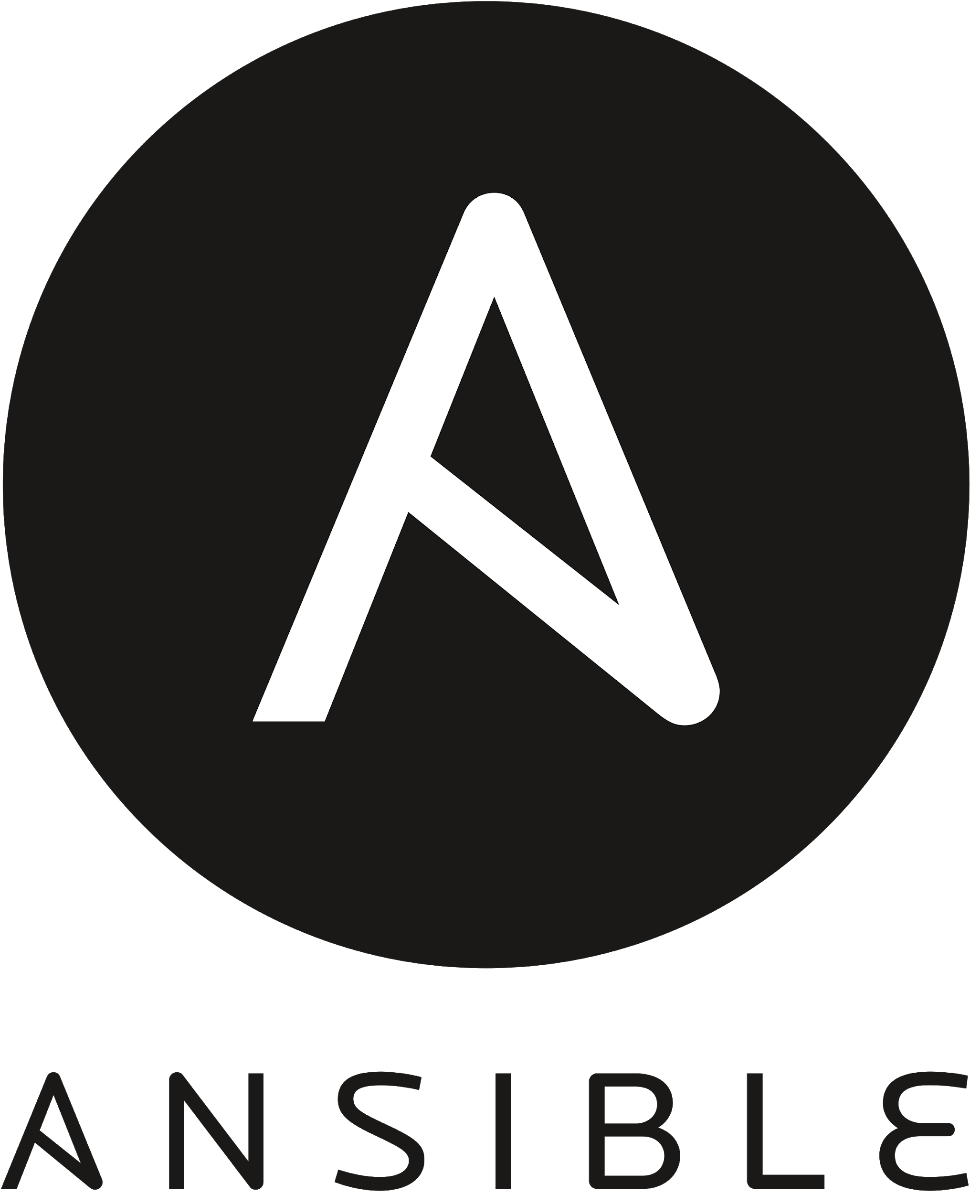
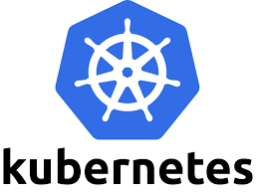

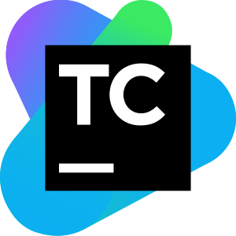























Container Orchestration Platform Demo
From Development to Build and Run on Platform
Overview
GIT COMMIT
RELEASE
Code / Debug
Build and Package
Run
CI Build
Deploy
DEVELOPMENT
CONTINUOUS INTEGRATION
Notes:
You can use any
OpenShift fits with and integrated into your organizations preferred toolchain - from coding to building to testing and deployment.

Slide 55
Q&A

Slide 56

Get hands-on after this session
Interactive courses right in your browser to continue your learning
CLOUD & CONTAINER NATIVE ROADSHOW - DEVELOPER TRACK
Try today at learn.openshift.com
Notes:
Red Hat Modernization and MIgration Solutions allow you to evolve your infrastructure, applications, and process while achieving desired business outcomes. The family of solution help address problems of increasing costs and complexity associated with long-term commitments to proprietary infrastructure and application environments, while reducing the dependence on associated vendor roadmaps with limited options and narrow visions. The family of solutions offers a path for organizations moving to cloud-native application development using containers, automation, and other transformative technologies and practices.
Let’s examine each of these three pillars and learn first hand how enterprises across the world have benefitted.

Slide 57

Get started with your Developer Sandbox for Red Hat OpenShift
Try today at developers.redhat.com
Notes:
Red Hat Modernization and MIgration Solutions allow you to evolve your infrastructure, applications, and process while achieving desired business outcomes. The family of solution help address problems of increasing costs and complexity associated with long-term commitments to proprietary infrastructure and application environments, while reducing the dependence on associated vendor roadmaps with limited options and narrow visions. The family of solutions offers a path for organizations moving to cloud-native application development using containers, automation, and other transformative technologies and practices.
Let’s examine each of these three pillars and learn first hand how enterprises across the world have benefitted.

Slide 58
Thank you
RED HAT SERVICES JOURNEY

